Slide 1



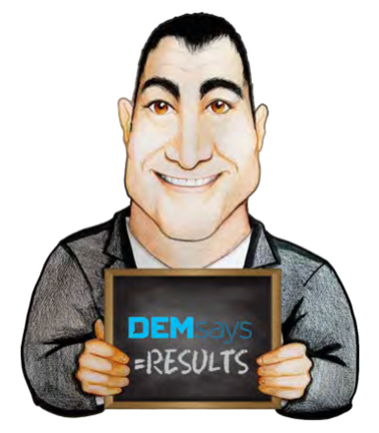


RATED R

Slide 2


RATED R!
Recruiter Analogies

Slide 3
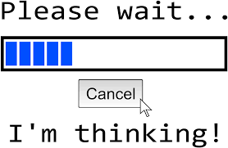
RATED R!
The Relationship Analogy
Making an Offer
I would like to think about it
1. An Offer
2. A Test

Slide 4

RATED R!
The Counteroffer Analogy
Have you ever broken up with anyone?
Do you really want out, or are you trying to modify their behaviour?

Slide 5


RATED R!
THE RELATIONSHIP CV
The average 32-year-old will change jobs
In a Decade!
3 Jobs in 5 years? Not a Job Hopper!

Slide 6


RATED R!
Rules of First Dates
Rules of 1st Dates
Rules of 1st Interviews
Never talk about your Ex
Never talk about your Ex-Boss
Don’t ask inappropriate questions!

Slide 7


RATED R!
Rules of First Dates
Rules of 1st Dates
Rules of 1st Interviews
Do ask about him/ her
Do ask questions about the client’s background

Slide 8

RATED R!
Prepping and Relationships
You are not YOU on a date. You are the ambassador of you.
The first interview is about the COMPANY.

Slide 9
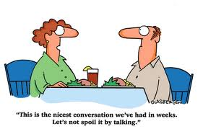
RATED R!
Rules of 1st Dates – Silence!

Slide 10

RATED R!
Survey
What is the most important attribute a man can have?
1.
4. Confidence
2. Intelligence
5. Generosity
3. Passion
6. Looks

Slide 11

RATED R!
Clients Requirements
Clients hire short- term solutions to short-term problems
What has to be done in the next 60 to 90 days?
Tell me about the last person who had this job.

Slide 12

RATED R!
Dating Euphemisms
You’re sweet.
You’re a really great guy.
You’re like a brother to me.
I had a great time, but I have to get up early.

Slide 13

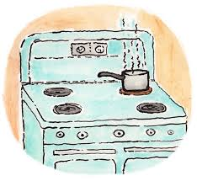
RATED R!
Recruiting Euphemisms
He’s a really good guy.
Let’s put her on the backburner for now.

Slide 14

RATED R!
Leaving Jobs and Relationships
SHOULD you leave?
You’re not miserable ALL the time
If you’re acting like you’re leaving your job, you’re leaving your job
Why did you return my call?
Sometimes we do the right things for ourselves before we have figured out why they’re right.

Slide 15

RATED R!
The “If you were Unemployed” Test
If you were unemployed and you interviewed for your job and the one I sent you to, which is the better job?

Slide 16

RATED R!
The Eulogy Close
If you know your story is not yet written, and at some point you WILL leave your job, then you should leave now if an opportunity arises. Do you agree?
Can we write your career eulogy now, or are there other ambitions?
Everyone deserves to live their life without reservation.
Do you believe what you’re being told?

Slide 17
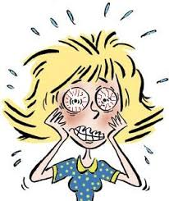
RATED R!
Let’s get Physical!
Pain is your body’s way of demanding change
Has your body made up its mind but you’re not listening?
Trouble sleeping?
How is this affecting you physically?
Trouble eating?
Are you stressed?

Slide 18
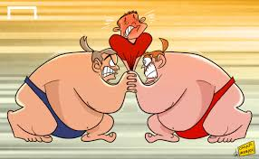
RATED R!
Stuck in the Middle
1. People want what other people want.
2. You feel sorry for them
3. Don’t come across desperate!

Slide 19
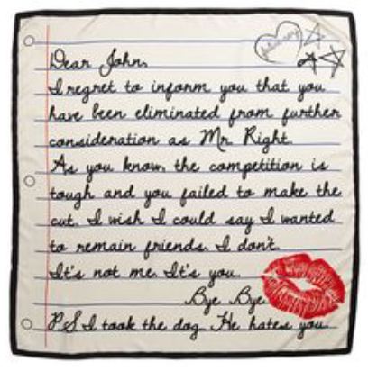
RATED R!
Going Dark!
1st Date = Brush Off
2nd Date = Must Break Up (Email or Voice Mail Ok)
3rd Date = Must Break Up (LIVE ON THE PHONE)

Slide 20

RATED R!
The Relationship Coma
Everything the person does is perfect!
Lasts about 3 months, luckily!
Then comes the disillusionment.
Here’s what we have to do if we’re going to get this person.

Slide 21


RATED R!
Prepping
You can argue,
Can you trust me with a few thoughts since I know the company? Let me help you.
You can use the Relationship Analogy

Slide 22

RATED R!
Debrief Calls
There is no connection between what a man says naked in the dark to what he will say the next day in broad daylight.
There is no connection to what a candidate says right after an interview to what they will say the next day.

Slide 23

RATED R!
Premature Exclamation!
Nobody want to be the first to say “I love you”
They don’t want to be on record as having said “I’m taking that job”.
What is the ANSWER to that?!

Slide 24


RATED R!
Honesty
Honesty is asked for, but white lies are expected.
There are times when honesty is NOT correct.
Leaving a job
A Breakup
A Breakup
Leaving a job

