Slide 1




Part 2
THE END GAME and
CLOSING DEALS

Slide 2

THE END GAME and CLOSING DEALS
The Salary Issue
OUR JOB
Sales position at Supply Chain company
CANDIDATE SITUATION
Unemployed
R175 000.00
Interviewing at 2 other companies
Loves our Job
SALARY RANGE
R170 000 – R190 000
Gets an Offer for R180 000 from other company.

Slide 3
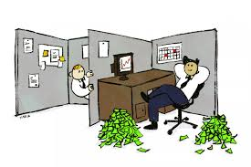
THE END GAME and CLOSING DEALS
The Salary Issue
Client tells Recruiter
We’re going to offer him R185K
Think we can get R190K?
Recruiter tells Client
Client tells Recruiter
OK

Slide 4
THE END GAME and CLOSING DEALS
The Salary Issue
Recruiter tells Candidate
Offer is going to be R185K.
What do you think?
Candidate tells Recruiter
Fantastic!
Recruiter tells Candidate
Well, I’m pretty sure I can get you R185K. I might even be able to get you…R190K!

Slide 5

THE END GAME and CLOSING DEALS
The Salary Issue
GUESS WHAT THE OFFER WAS????

Slide 6


THE END GAME and CLOSING DEALS
The Salary Issue
1. There is no Salary Range as far as dealing with your candidates goes.
2. You represent the interests of the client when talking to the candidate and vice versa.
3. Close Candidates low and Clients high.
What’s the trade off for the company?

Slide 7
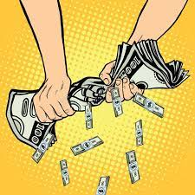
THE END GAME and CLOSING DEALS
The Salary Issue
4. No amount is reasonable.
No request is a sure thing.
5. Squeeze the party who has the least options.

Slide 8

THE END GAME and CLOSING DEALS
Resignation Training
Candidate:
“I Accept!”
Call 1:
“Celebrate!”
“When are you going to resign?
You need Resignation Training.”
Call 2:

Slide 9

THE END GAME and CLOSING DEALS
Resignation Training
This is a SHORT INFORMATIONAL MEETING. It is not an EXIT INTERVIEW.
What is your relationship like with your boss? Do you want to make this painless?
Get to the point: “I’m leaving”.
You are not at liberty to discuss where you are going or what they are paying you.

Slide 10

THE END GAME and CLOSING DEALS
Resignation Training
“It’s too late to keep it confidential”
Nobody ever leaves a job without leaving SOME money on the table.
It doesn’t matter anymore.
Ask for immediate release/ start date.
Go do it NOW!

Slide 11
THE END GAME and CLOSING DEALS
Resignation Training
1. The Money Aside Close.
Money aside, can you say you will take the job?
Are you looking for a graceful way out of this? Because you don’t need to. I can get you out. I’ll just withdraw you from the process.
2. Are you looking for a graceful way out?
3. The Eulogy Close.
Are you planning on staying there forever?

Slide 12
THE END GAME and CLOSING DEALS
Resignation Training
4. The If you were Unemployed Close.
You have to ask yourself, if you were unemployed, and you could interview for the job you have now, and the one that is pending with my client, which would you take?
5. The Take it Away Close
You’ve had the offer for 4 days. I think your answer is ‘no’. So, I’m going to call the company and tell them it’s over.
6. The Now that it’s Over Close.
Now that it’s over, what was the real reason why you didn’t want the job?

Slide 13

THE END GAME and CLOSING DEALS
Do you have that in blue?
Do you want it if I do?

