Slide 1



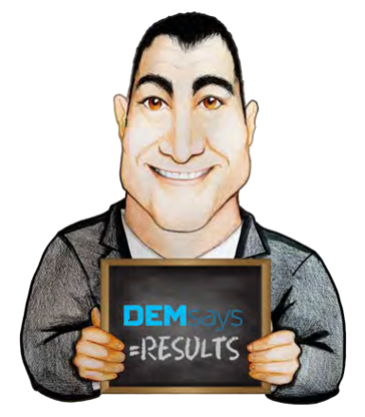
MARKETING MADNESS

Slide 2

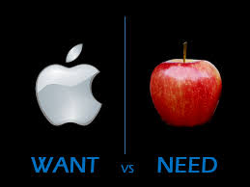
MARKETING MADNESS
Why Market?
…nothing else matters
Because without a
Because of the unpredictable nature of our business
ATTITUDE: I WANT your business; I don’t NEED your business!

Slide 3


MARKETING MADNESS
Marketing Do’s & Don'ts
10 Years Ago
30
Calls
1 Job Order
5 Years Ago
25
Calls
1 Job Order
Lots of Vacancies
Big Companies
Lots of Money
Lots of Bureaucracy

Slide 4

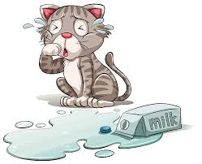
MARKETING MADNESS
Marketing Don'ts
Don’t Panic!
10:1
25:1
40:1
=
4 x as many Calls
Don’t discount your Fees
Don’t get Desperate
I want your business.
I don’t NEED your business
Too much psychological investment in too few things!

Slide 5


MARKETING MADNESS
Marketing Do’s
A Physical Plan
Get rid of distractions
Number of Calls?
Balance your Desk
Talk to Senior Line Managers in small to medium sized companies

Slide 6

MARKETING MADNESS
Quick History Lesson
Candidate Presentation Marketing Call
Service Marketing Call
You DO NOT get Job Orders from making Service Calls
You cannot sell if you’re not giving somebody an opportunity to BUY something
It’s all about Placing candidates

Slide 7


MARKETING MADNESS
MPC = Most Placeable Candidate
What makes an MPC?
What does that mean?
Candidates History or Track Record
=
Numbers

Slide 8


MARKETING MADNESS
What is Awesome?
Don’t tell me, show me
How is your candidate measured?
What are your achievements and accomplishments?

Slide 9

MARKETING MADNESS
MPC = Most Placeable Candidate
What makes an MPC?
They must know what they want
Availability

Slide 10


MARKETING MADNESS
MPC = Most Placeable Candidate
The Introduction
The Body/ Message
Resolution/ Close

Slide 11

MARKETING MADNESS
MPC Script INTRO
WHO?
WHERE?
SPECIALISE
[NAME], this is [YOUR NAME], from [ABC]. I specialize in Sales and Marketing talent.

Slide 12

MARKETING MADNESS
MPC Script BODY / MESSAGE
I’ve just recruited a Corporate Accounts Manager with numbers I don’t see too often. She has achieved 156% of target for 5 straight years and can hand you key account giants like Alexander Forbes and RMB.

Slide 13
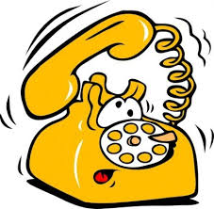
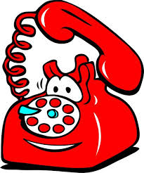

MARKETING MADNESS
MPC Script CLOSE
She’s on the market for the right opportunity and has asked me to approach some companies she respected. You were on top of her list, and I thought you should know about her.
I have her going out to 2 other companies early next week, but I thought you might also want to meet with her.
What are your thoughts about meeting with her?

Slide 14
MARKETING MADNESS
Marketing Process
MPC Call: No Job Order
An hour later: Follow Up Email
Marketing Process
A week later: Send an Article
A week later: Phone Call
3 weeks later: MPC Call

Slide 15
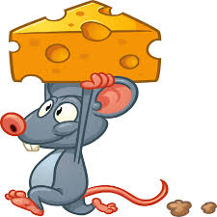
MARKETING MADNESS
Move your Cheese!
Stop saying…
Do you have any vacancies?
Here’s what you DO say…

Slide 16
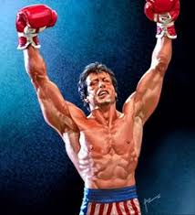
MARKETING MADNESS
The “Challenge Me” Script
What type of person sitting in your competitor right now could I bring to you where you would say to me, even in this market I have to hire someone like that. If he can do X, then I’ve got to hire him. Who is that person? Let me see if I can deliver’

