Slide 1




SALES
AND
THE MODERN RECRUITER

Slide 2
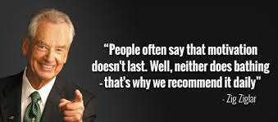

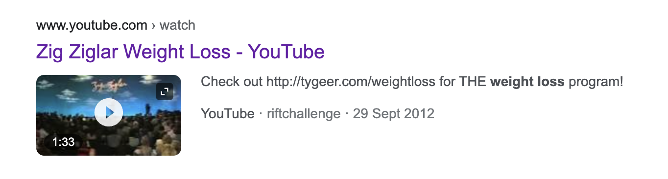
SALES and THE MODERN RECUITER

Slide 3

SALES and THE MODERN RECUITER
If you want to be in sales, you should LEAVE if you can!
You can’t get out of something you were never in.
Talking is SHARING
Are you still there?
Reciprocity
Listening is CARING

Slide 4
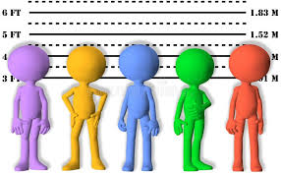
SALES and THE MODERN RECUITER
Prospecting
Prospecting: The only problem with making a sale is, it means you just lost your best prospect!
Pipeline, not Pipe Dreams: Consistent ACTIVITY
The Difference
between
Prospects and
Suspects
A Prospect is
someone who
you INVEST
TIME WITH
A Suspect is someone who you SPEND TIME WITH
Covering Jobs
You have to question your own JUDGEMENT

Slide 5


SALES and THE MODERN RECUITER
Zig and the Alphabet
K.I.S.S | Keep It Simple Stupid
A.A.F.T.O | Always Ask For The Order
A.B.C | Always Be Closing
P.O.G.O
P | People
O | Organization
G | Goals
O | Obstacles

Slide 6

SALES and THE MODERN RECUITER
The Modern Recruiter World
The Circle of Influence
You get Specifics by starting UNIVERSAL
If people are the kind of people who like to give Referrals, they like to give multiple Referrals.
While I’ve been talking to you, have you thought of anybody else?
Who do you think I should call first?
Reporting Back

Slide 7
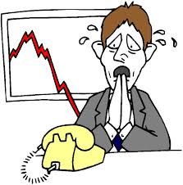
SALES and THE MODERN RECUITER
Call Reluctance
It’s GOOD to be nervous!
Start prospecting the same time every day.
You can’t get rid of butterflies, but you can get them to FLY IN FORMATION
Objectives and Outlines

Slide 8
SALES and THE MODERN RECUITER
Suggest the Outcome you want
NO MORE
Do you have a moment to talk?
Motivation!
No-one buys Products. They buy the Products of Products
Great recruiters CREATE needs and wants
Don’t tell me who your candidate IS. Tell me what she can DO for me.
W.I.I. FM
What’s in it for ME?
The Fear of Loss is Greater than the Desire for Gain

Slide 9


SALES and THE MODERN RECUITER
3 Powerful Qualifying Questions
Can you see how this would save you money?
Are you seriously interested in saving money?
When do you think would be the best time to start saving money?

Slide 10

SALES and THE MODERN RECUITER
Overcoming Objections
People don’t change their minds. But they DO make new decisions based on new information.
Reference Check and Summary Close
“The way to get what you want in life is to get everyone else everything THEY want in life”.

