Slide 1

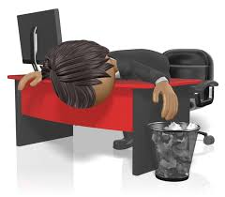


SLUMPS 2.0!

Slide 2
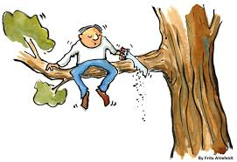
SLUMPS 2.0!
Questions...
Why do we Self-Sabotage?
Why don’t people do the things necessary to be successful?
DEFINITION: Self-Sabotage is any action that interferes with your Intention
Once you are successful, why do you STOP?

Slide 3

SLUMPS 2.0!
Why do we Self-Sabotage?
1. Because you don’t know your WHY?
2. We never UPDATE it! What’s driving you TODAY?
3. Self-Sabotage is always about a deep sense of inadequacy
4. The Brain wants consistency

Slide 4

SLUMPS 2.0!
DEMsays Mentoring Meetings
Meeting #1:
Be good to yourself
Meeting #2:
You are Exceptional, but I don’t make Exceptions
Meeting #3:
Sabotage is absent in the presence of contribution

Slide 5

SLUMPS 2.0!
DEMsays Mentoring Meetings
Meeting #4:
Darwinian
Meeting #5:
It’s time to rewrite the story
Success comes from learning to stop yourself from doing what you’re not supposed to do

Slide 6
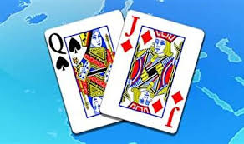
SLUMPS 2.0!
Behavioural Changes
Triggers are Stimulus that reshape your thoughts and actions
FATE is the cards you’re dealt. The CHOICES you make are how you play that hand

Slide 7

SLUMPS 2.0!
Behavioural Changes
3 Problems with Behavioural Changes:
1. You can’t admit to yourself that it’s YOU
2. You don’t appreciate the Power of Inertia
3. You have the motivation, but you lack the Knowledge

Slide 8
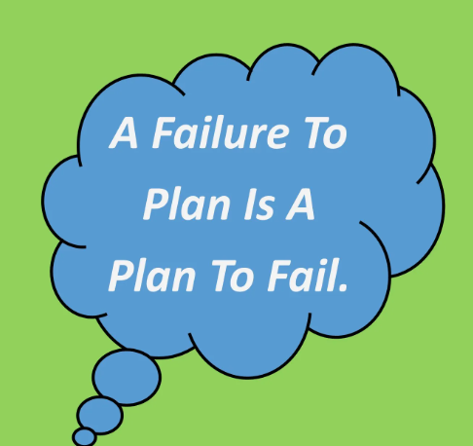
SLUMPS 2.0!
Most people are great Planners and terrible Doers
Recruiters are great Doers and terrible Planners
The longer you put it off, the less creative you’ll be

Slide 9

SLUMPS 2.0!
3 Hard Questions:
3 Problems with Behavioural Changes:
1. What do you want to change?
2. What Behavioural Changes have you tried to make?
3. “How is your way working out?"

Slide 10
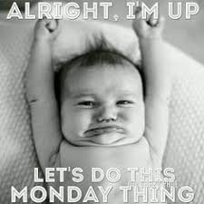
SLUMPS 2.0!
How do we Fix this?
Not just WHAT, but also WHEN
Science of Depletion
What’s the 1st thing you should do on Monday morning? MONEY CALLS!

Slide 11
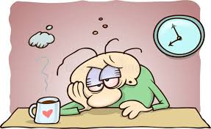
SLUMPS 2.0!
Result of Decision Fatigue is:
1. DO NOTHING
2. You talk too much when you’re depleted
3. You’re more arrogant when you’re tired
4. You’re more Passive and therefore less able to Persuade

Slide 12

SLUMPS 2.0!
Top 6 reasons Why don’t we make Changes
1. We glorify Willpower
There are things that you care enough about to do and there are things that you don't.
2. I can’t do it today because today is “special”
3. At least I’m better than...

Slide 13


SLUMPS 2.0!
Top 6 reasons Why don’t we make Changes
4. I don’t need help, I’m a Manger/ Senior Recruiter
5. I have time…
6. If I change, I’m not ME

Slide 14


SLUMPS 2.0!
Basic Behavioural Psychology
Don’t Ask: Did I make enough calls today?
DO Ask: Did I do my BEST to make enough calls today?

Slide 15
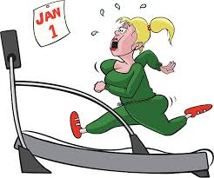
SLUMPS 2.0!
Bad Habits and Change
New Years Resolutions
Only 9.2% of people who make New Years Resolutions stick to them
Work Resolutions fail at exactly the same rate
33% violate them by the end of the first week!

Slide 16
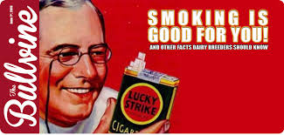
SLUMPS 2.0!
Why do they Fail?
1. Cold turkey doesn’t work
2. The Trappings
3. Too focused on Stopping rather than Doing
4. Ignorance
“Abs are made in the….?"

Slide 17

SLUMPS 2.0!
Why do they Fail?
DEMsays...“Too small to Fail”
5. Not Intentional enough
6. Motivation is misunderstood = Adrenaline
Developing a Habit takes 18 to 254 days
Goal = Have a decreased level of Emotion behind the behaviour
The key to developing a Habit is: How badly do you want the result?

Slide 18


SLUMPS 2.0!
Time to Turn Pro!
Defining the "Good Life"
Everyone wants to be better at something!
1. Owning a house
2. One holiday per year
3. Every adult owning a car
4. Pay for education of your children

Slide 19

SLUMPS 2.0!
Time to Turn Pro!
3 Models to being “better”
1. Therapeutic Model
2. Moralistic Model
3. Amateur Versus Pro!

Slide 20

SLUMPS 2.0!
Time to Turn Pro!
Amateurs: Distractions or Addictions get in the way
The further we drift away from turning Pro, the harder it is to get back
Pros: Actively resist Addictions
Amateurs: Crave 3rd Party validations
Pros: Don’t have to see others fail

Slide 21


SLUMPS 2.0!
Amateurs: Permit Fear to stop their action
Pros: So what if I fail!
2 Fears of Amateurs:
1. Solitude
2. Silence

Slide 22
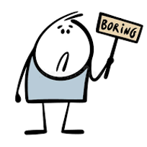
SLUMPS 2.0!
Amateurs: Are Infants!
Pros: If you want something it’s going to cost you
Amateurs are always going to be ready “tomorrow”
Living as an Amateurs is Boring!
All distractions, addictions, end the same way:
Repetition without Progress = Incapacity!

Slide 23


SLUMPS 2.0!
Failure hates 2 things:
1. Concentration
Pros: No Back-Up Plans
2. Depth
Pros: Show up every day!
The first rule of Success is…Be there.

Slide 24
SLUMPS 2.0!
PROS: | Does not wait for Inspiration. They work in anticipation of it
PROS: | Are Prepared
PROS: | Master techniques
PROS: | Ask for help when they need it
PROS: | Will not be distracted
PROS: | Defer Gratification

Slide 25



SLUMPS 2.0!
How do you turn Pro?:

Slide 26


CONTACT DEM
“…there is not much wrong in any of our lives that a placement doesn’t fix…”
082-929-5148
dem@demsays.co.za

