Slide 1







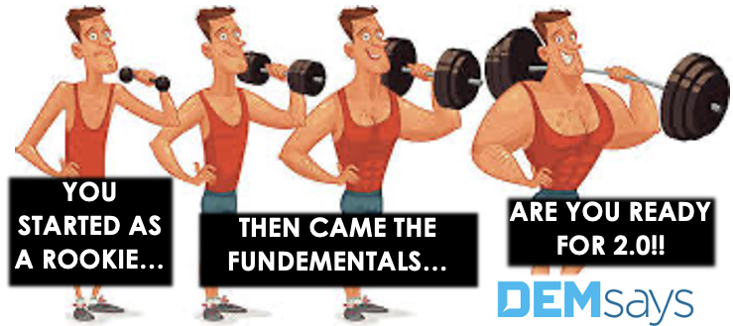
RECRUITER TRAINING SERIES

Slide 2


RECRUITING HAS CHANGED…
HAS IT? 2.0!

Slide 3

RECRUITING HAS CHANGED… HAS IT? 2.0!
Word for Word Email to Dem:
On 02 April 2025, at 15:30, <@> wrote:
Dem, so what is happening? I'm still working after almost 40 years in the business. I can't believe it. So here's my question. Phone times are disgusting, and they claim everything is email. Here are some numbers. Recruiter number one, 108 calls for the week. Recruiter number two, 112 calls for the week. Recruiter number three, 192 calls for the week. Phone numbers run from five hours to seven hours for the week. Am I just old school? They're averaging one placement a month. I'm ready to come down on them, because after nice training sessions, nothing is changing. Your thoughts?
Kind Regards,

Slide 4

RECRUITING HAS CHANGED… HAS IT? 2.0!
Social Media has created a MORE Isolated society, NOT LESS!
We isolate ourselves in a Cocoon of Self Interest
“…whoever makes a deliberate effort to break us through to our natural state, will be rewarded…”

Slide 5
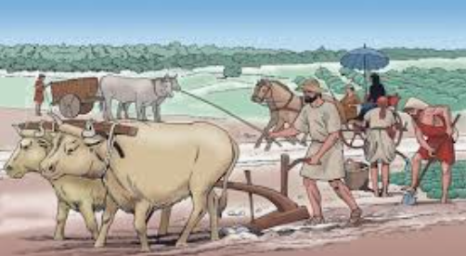
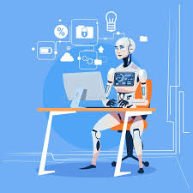
RECRUITING HAS CHANGED… HAS IT? 2.0!
Changes in Civilization
1. Farming to Industrial
2. Industrial to Internet
3. The NEW Internet has become the Narrative Internet

Slide 6
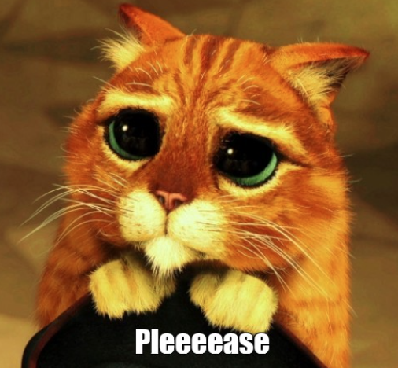
RECRUITING HAS CHANGED… HAS IT? 2.0!
How Different are things Now?
“Can you please send me the JD and the name of the company before we speak?”
Change? Candidates won’t talk on the phone.
DEMsays…"Puleeeeze, stop Emailing Job Descriptions…"
We RESIST sending it

Slide 7

RECRUITING HAS CHANGED… HAS IT? 2.0!
What really Changes?
Is it, Technology makes it easier?
Is it, all Recruiters are sending Job Descriptions?
Is it, "I will not talk on the phone…”?

Slide 8



RECRUITING HAS CHANGED… HAS IT? 2.0!
New Generation?
Are spoiled?
Not empathetic?
Are Narcissistic?
Are entitled?
Don’t know how to communicate?
Wrong! YOUTH is Narcissistic!

Slide 9
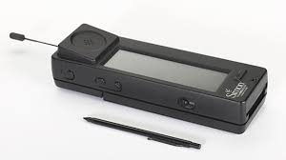



RECRUITING HAS CHANGED… HAS IT? 2.0!
The Smartphone is 30 years old
1994 =
2% Penetration
2011 =
33% Penetration
2025 =
96% Penetration

Slide 10
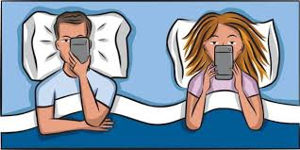
RECRUITING HAS CHANGED… HAS IT? 2.0!
Alone Together: “You are where your attention is…”
Most people check their phones 85 times a day = Emotional Effort to talk to people!
Intimacy is UNUSUAL
The best Recruiters create INTIMACY in a phone call

Slide 11
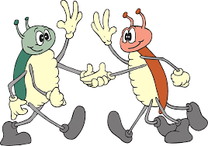
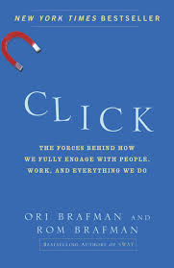
RECRUITING HAS CHANGED… HAS IT? 2.0!
CLICK!
Click
=
Quick Set Intimacy
1. Can define it
2. Can increase your abilities with it
3. Can bring it on

Slide 12

RECRUITING HAS CHANGED… HAS IT? 2.0!
Quick Sight Intimacy CREATES a Unique Euphoria
AND, it alters the relationship, PERMANENTLY!
How to Create CLICK…
VULNERABILITY is the number one accelerator to clicking

Slide 13
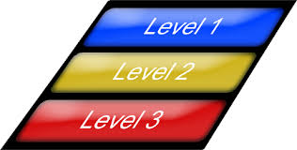
RECRUITING HAS CHANGED… HAS IT? 2.0!
Levels of Vulnerability…
1. Phatic Statements
2. Factual Statements
4. Gut Level Statements = Where you reveal something personal
3. Evaluative Statements
We limit ourselves to those who we feel are close to us.
5. Peak Statements = Innermost thoughts

Slide 14
RECRUITING HAS CHANGED… HAS IT? 2.0!
Memory atrophies because of being connected all the time.
1. "They have already sent your CV to the company…”
Persuasion Skills are NOT old fashioned!
2. “We will not submit your CV to a company without your permission”
“Who’s the Company?”
Two Protocols Rebuttal
DEMsays: “…two different protocols…”
“…which one of those 2 protocols do you think is better?”

Slide 15

RECRUITING HAS CHANGED… HAS IT? 2.0!
“…I’m not at liberty to tell you it is until we’ve taken the next step…"
“Who’s the Company?”
“I need to protect my client as well as myself…"
“…they use an agency for Quality, for Validation, and Confidentiality…"

Slide 16

RECRUITING HAS CHANGED… HAS IT? 2.0!
What have you got to lose? Check it out!
As long as you are Consistent with it!
DEMsays: “…I expect you to be opportunistic, and I understand the company has to compete for your talent. At the same time, I don’t want you wasting my time…"
“..I’m hesitant about sending you…” “…I’ll play a hunch…” “…can we just make a deal with each other…”
“If you don’t want it, you owe me!"

Slide 17
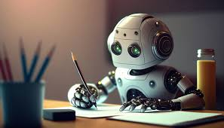

RECRUITING HAS CHANGED… HAS IT? 2.0!
Let’s Relax about AI!
AI = A Sophisticated Recruiter Assistant!
It WILL limit the apprenticeship of new Recruiters

Slide 18

RECRUITING HAS CHANGED… HAS IT? 2.0!
People are still People!
3 things that Humans are concerned about:
1. What they’re going to Eat
2. Always afraid of BEING eaten!
DEMsays: “You’re special because you’re a CONNECTOR…"
3. Obsessed with Procreation

Slide 19

RECRUITING HAS CHANGED… HAS IT? 2.0!
People go to work for People
1. Money
They will always care about:
2. Family Needs
“Send me the Job Description”
3. Fun
DEMsays: “If I wasn’t working on several searches at once, I’d be starving! But we need to set a time to speak and get to the basics about you so I can talk to you about the RIGHT opportunity…”
Alternate Choice Close: 3:30 today or 5pm?

Slide 20


CONTACT DEM
“…there is not much wrong in any of our lives that a placement doesn’t fix…”
082-929-5148
dem@demsays.co.za

