Slide 1
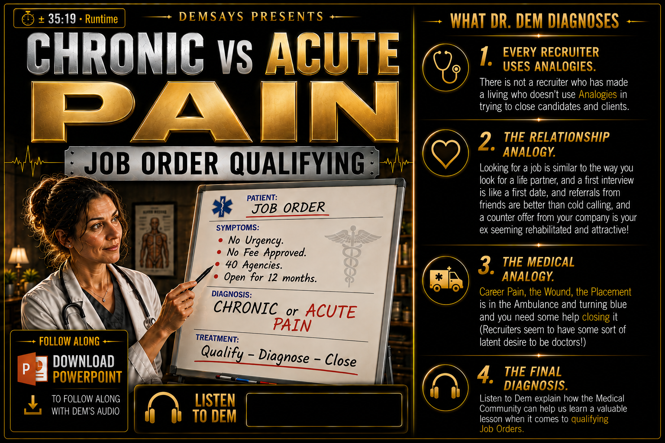


Slide 2

Chronic vs Acute Pain Job Order Qualifying
Remember “Rated R”?
We’re back with more Analogies!
Medical Analogy:
Career Pain
The Wound
The Placement is in the ambulance turning blue
Recruiters have a latent desire to be Doctors!

Slide 3
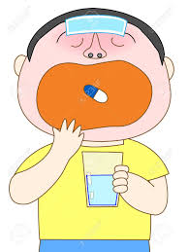
Chronic vs Acute Pain Job Order Qualifying
100% = Acute Pain = Take the Medicine
50% = Chronic Pain = Take the Medicine
Medical Analogy = We’re great at dealing with Disease/ Hot Jobs
Acute Pain = Severe, Intense
Chronic Pain = Gradual, Persistent

Slide 4

Chronic vs Acute Pain Job Order Qualifying
Acute Pain = Direct Cause and Effect
When you have Acute Pain, nothing is possible!
Most of the Jobs you end up filling are Acute Pain jobs

Slide 5

Chronic vs Acute Pain Job Order Qualifying
Neglecting Chronic Pain is not instantly punished
Chronic Pain:
No Real Urgency. Need someone, just not NOW
Open to Multiple Solutions/ Other
Sensitive to Price
“…maybe it’ll go away…”

Slide 6

Chronic vs Acute Pain Job Order Qualifying
Acute Pain:
Convenience means nothing! Becomes a Secondary matter.
Extraordinary Conviction to get done what is inconvenient, AKA...URGENCY!

Slide 7


Chronic vs Acute Pain Job Order Qualifying
ACUTE
Have Access to the Decision Maker
CHRONIC

Slide 8

Chronic vs Acute Pain Job Order Qualifying
You want to hear the diagnosis, AKA…DEBRIEF!
No one gets a 2nd Opinion if they LIKE their Doctor!
Medical Analogy: A 2nd Agency is a 2nd Opinion

Slide 9

Chronic vs Acute Pain Job Order Qualifying
Qualifying Question to Doctor:
How many of these procedures have you done?
Qualifying Question to Recruiter: How many [Titles] have you placed in this niche?

Slide 10


Chronic vs Acute Pain Job Order Qualifying
Credibility = Data Points:
Time to Fill Ratio/ Number of years in business
“…why are you punishing me for my expertise…"

Slide 11

Chronic vs Acute Pain Job Order Qualifying
Organ Donors
If you ask twice, with time in between, the majority say YES!
You self consciously reconsider something that made an impression on you!
“…how do I get more business?"

Slide 12

Chronic vs Acute Pain Job Order Qualifying
When a client fills a job: “Congratulations! Lets’ talk about the Bridesmaids…"
Reverse Tracking: Referrals to Business, Referrals to Candidates
Stay Aware and Chip Away.

Slide 13

Chronic vs Acute Pain Job Order Qualifying
Controlled Desperation
=
“…I HAVE to make something happen today!”
It’s not about how good a recruiter you are.
It’s about the JOB you’re working!

Slide 14

“…there is not much wrong in any of our lives that a placement doesn’t fix…”

