Slide 1

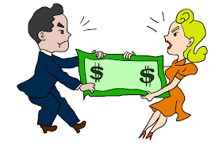

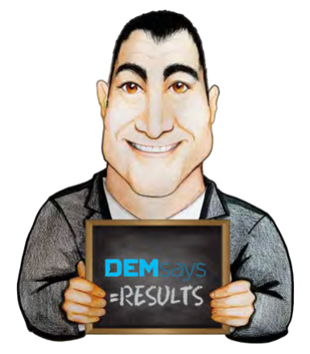
FEE FIGHTING

Slide 2
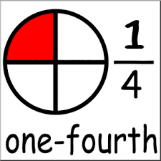
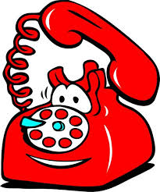
FEE FIGHTING
Here’s the Statement
We charge ONE FOURTH of the guaranteed annual cash compensation of the candidate.

Slide 3

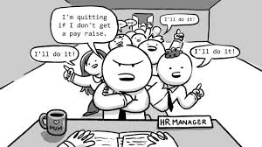
FEE FIGHTING
Some Basics
You are UNDERPAID!
Everybody likes to negotiate 3 times before they say “YES”
Start your negotiating Higher.

Slide 4
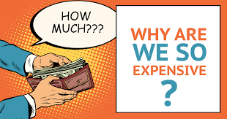
FEE FIGHTING
The Classics
Admit you are Higher
We’ve been in business for [X] years, and after [X] years we have ALWAYS been 10% higher. The question you have to ask yourself is, if we are 10 to 15% higher, how have been this successful and lasted this long? Somebody’s paying it. Why are they?

Slide 5
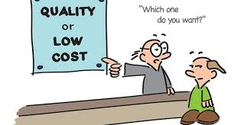
FEE FIGHTING
The Classics
Correlation between Cost and Quality
You may be right. There are certainly people who will do it for less. Let me ask you one question. Does anyone in your industry sell his or her product/ service for less than you? And is their product better than yours? Don’t you think the relationship between cost and quality applies to search companies as well?

Slide 6
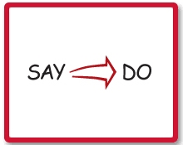
FEE FIGHTING
The Classics
Correlation between what they SAY they charge and what they DO charge
They charge less because you ask them to, but they charge the companies in your industry with more contemporary fee policies a full fee. The candidates those companies reject they send to you. They don’t tell you that, and who can blame them. I want to be able to send you my best people first. Does that make sense?

Slide 7


FEE FIGHTING
The Classics
Contingency
Most of my clients use other sources, some less expensive and some more, and then hire the best candidate.
Our whole multi-billion rand industry is built on that notion, and the only risk until you hire is mine. So why do you care what the fee is?

Slide 8

FEE FIGHTING
The Classics
Discount for Volume Business
Great, then I will be happy to give you my sliding scale discount plan where you pay a full fee now, to establish our relationship, but earn a continuing discount as we go.
If there truly is business down the road, this is fair for both of us.

Slide 9

FEE FIGHTING
The Classics
Negotiating After the Fact
I respect anyone trying to negotiate lower costs before a service is provided, because then a choice can be made, but I don’t respect what you’re doing now. You knew the fee upfront, and I will not change it now. It’s a matter of principle.

Slide 10

FEE FIGHTING
The Classics
Sometimes you are going to lose.
Move On!
If you can’t overcome the fee objection, rather than work for less, hang up the phone and make 5 more calls.

Slide 11
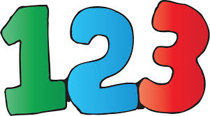
FEE FIGHTING
The Trilogy of Phrases
The 3 most important phrases about overcoming the fee objection are the following
1. Does that make sense?
2. On a contingency basis the risk is mine.
3. Let me compete and you hire the best person.

Slide 12
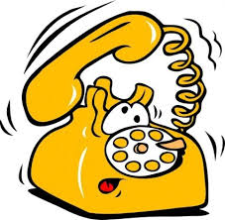

FEE FIGHTING
The “Getting Approval” Rebuttal
If I could make the fee more affordable, then I’d have the opportunity to work on this search for you, is that right?
YES!
Ok, I can’t get any change in my fee approved without some sense of what I’m getting myself into.

Slide 13
FEE FIGHTING
The “Getting Approval” Rebuttal
This frees you up to take the Job Order because the client assumes you are going to negotiate.
The critical nature of the search
The money that is being lost by the client due to the position being open.
The value of the recruited candidate.
Their urgency and the commitment that requires.
You must then emphasize

Slide 14


FEE FIGHTING
The “Shadow of a Doubt” Close
If you knew beyond a shadow of a doubt that the person you hired through me was going to be one of your top performers at your company for years to come, would you really have a problem with my fee?
Trilogy of Phrases

Slide 15


FEE FIGHTING
The “Shadow of a Doubt” Close
What are you paying other agencies?
What has made you consider using an agency at this point?
What’s the MOST you’ve ever paid??

Slide 16
FEE FIGHTING
DEMsays…
“If you don’t believe you’re worth your fee, you will never convince anyone else, least of all your clients”!

