Slide 1



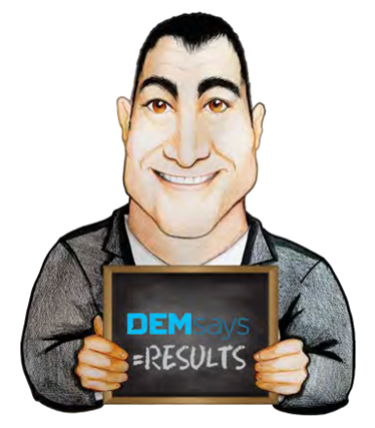
THE END GAME and
CLOSING DEALS – Part 1

Slide 2

THE END GAME and CLOSING DEALS
Fundamental Rules
STOP ASKING:
What else do you have going?
What other interviews have you been on?
What other offers do you have?
Where else have you sent your CV?
Is there anything internally posted?

Slide 3
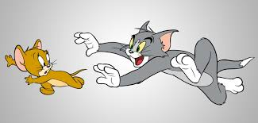
THE END GAME and CLOSING DEALS
Fundamental Rules
3. There is always only one offer.
1. Top billers suggest the results they want.
I suggest you…
You’re on the shortlist
2. There is never only one candidate.
4. In successful deals, the players chase YOU!

Slide 4

THE END GAME and CLOSING DEALS
1ST Interview Debrief
Debrief Calls should never be…
IMPROVISED!
First Interview Debrief
Objectives of the Debrief Call
1. To further the placement process with the candidate.
2.Gather information
3.Establish your VALUE in the process.

Slide 5
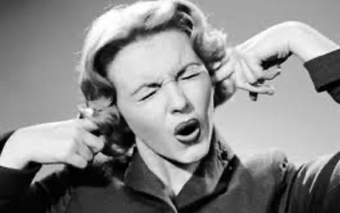
THE END GAME and CLOSING DEALS
Start with an open- ended question.
Tell me about the interview.
How did it go?
What happened?
Ok, great, let me get more specific.
Walk me through what happened.
Who did you talk to/ meet with
What were their titles?
Ignore the Objections for now.

Slide 6

THE END GAME and CLOSING DEALS
Was the interview TECHNICAL or PERSONAL?
What do you think their 3 hiring priorities are?
Can you do the job? WHY?
What did they ask?
Did you talk about money?

Slide 7
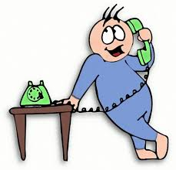
THE END GAME and CLOSING DEALS
How does this compare to other things you have going?
What are the positives? How important is that to you?
SPECIFICALLY, how did you leave things?
What are the negatives?
Gut feeling?

Slide 8
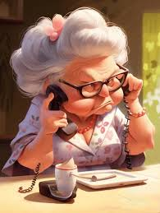
THE END GAME and CLOSING DEALS
Summary Close
Based on what you now know, if they want to see you again, do you want to pursue?

Slide 9
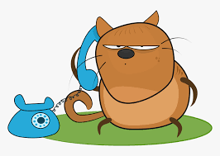
THE END GAME and CLOSING DEALS
Final Interview (Client)
4. Will they meet anyone else? Who?
1. Great. WHY?
5. Will an offer be extended? At what amount?
2. What is it that you’re trying to measure?
3. What will happen at that meeting?
6. I assume there are other candidates.
Compare them please.

Slide 10

THE END GAME and CLOSING DEALS
Final Interview (Client)
9. How can she prepare?
7. Have their interviews been scheduled? When?
10. If the interview is going well, you’ve got to stay in selling mode.
8. If everyone was the same technically, who would you hire as a person?

