Slide 1




STALKING AND TENACITY!

Slide 2
Stalking vs Tenacity
Stalking
=
Willful, Repeated, and Malicious Following of an individual
1 in 20 women will be stalked in their life!

Slide 3
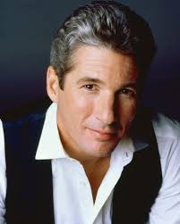
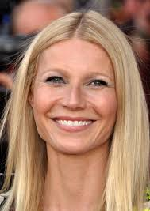
Stalking vs Tenacity
Richard Gere
vs
Ursula Habbishaw
Gwyneth Paltrow vs
Dante Soiu

Slide 4
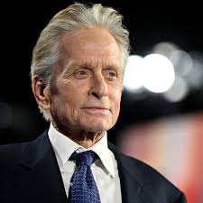
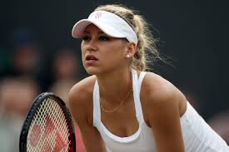
Stalking vs Tenacity
Michael Douglas vs Dawnette Knight
Anna Kournikova vs
William Lepeska

Slide 5
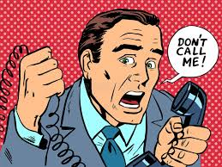
Stalking vs Tenacity
Tenacity = Persistent Adhering to, or Seeking of something or someone of value
STALKER:
Multiple Calls to get someone's attention
Finds personal information online
Heightened sense of their own importance
SOUND FAMILIAR?

Slide 6


Stalking vs Tenacity
Stalker Daily Plan:
Gather Personal Information
Multiple Calls every day
Send inappropriate gifts

Slide 7

Stalking vs Tenacity
Stalker Daily Plan:
The Rescue Technique (take petrol out your car/ air out of tyres)
What’s Apping/ Emails/ Sending Invites

Slide 8

Stalking vs Tenacity
Leaving Messages...
Refresher from Closing 2.0!
Espresso Take Away Close
Decaffeinated Take Away Close
Caffeinated Take Away Close

Slide 9


Stalking vs Tenacity
Real Life Training Exercise: Let’s Stalk some people!
Group One: Good Job Order Call, then GHOST!
Exercise = 3 Escalating Messages

Slide 10


Stalking vs Tenacity
Real Life Training Exercise: Let’s Stalk some people!
Group Two:
The Candidate hasn’t called back
Exercise = Email

Slide 11


Stalking vs Tenacity
Real Life Training Exercise: Let’s Stalk some people!
Group Three: Client won’t get back to you after you worked the Job
Exercise = Call the PA!

Slide 12

Stalking vs Tenacity
Group One, Message One: Vanilla
Group One, Message Two: Guilt
Group One, Message Three: Stalking and Lost Sale Close!
“…what did I do wrong…"

Slide 13

Stalking vs Tenacity
Group Two, Message One (Email): Deadline
Group Two, Message Two: Pet excuse!
Group Two, Message Three: “…are you okay?"
Remember: Email seems like a threat. Voicemail seems like a joke.

Slide 14

Stalking vs Tenacity
Group Three, Message One: We will lose this candidate
Group Three, Message Two: Decaf
Group Three, Message Three: Stalker AND Rescue!

Slide 15
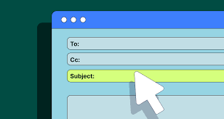
Stalking vs Tenacity
Caffeinated Ghosting
The Subject is Subject Lines:
The Open Rate is always about your SUBJECT LINE. The Response Rate is always about your CONTENT
80% of your time should be spent on Subject Lines!

Slide 16



Stalking vs Tenacity
1. Statement of Fact
2. "…made me think…”
3. “…made me feel…"
4. “…so I’m asking…"
5. “…and I promise to…”

