Slide 1



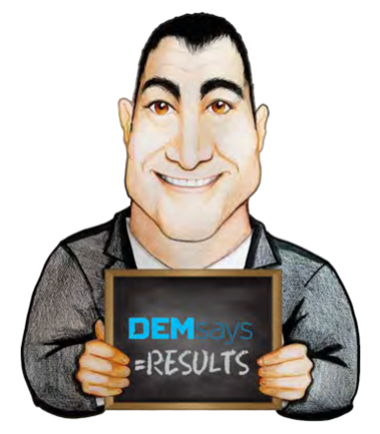
6 DEGREES OF SEPARATION

Slide 2
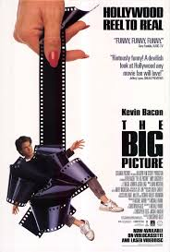
6 DEGREES OF SEPARATION

Slide 3
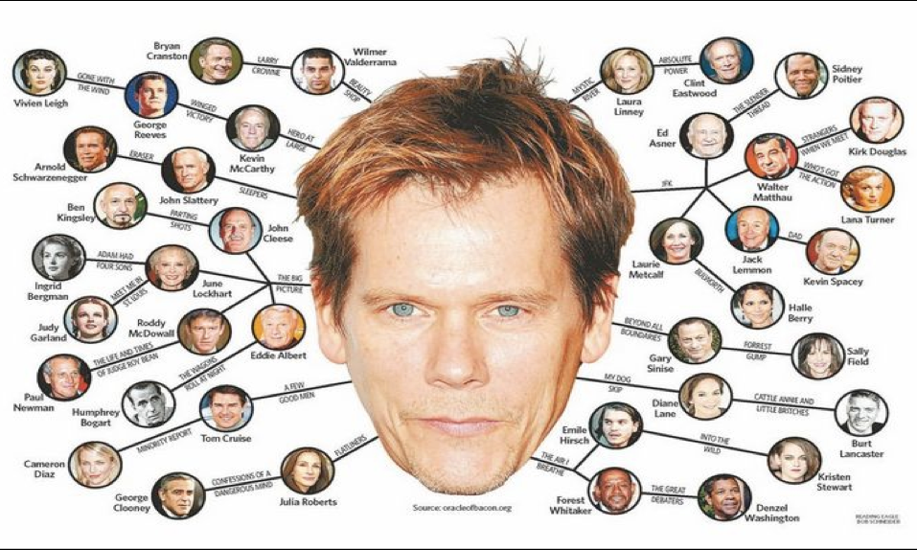
6 DEGREES OF SEPARATION

Slide 4

6 DEGREES OF SEPARATION
Paul Erdos and Kevin Bacon
Connections between people have nothing to do with…
Recruiters only call people in their database who they see as matches for their jobs.

Slide 5

6 DEGREES OF SEPARATION
The Strength of Weak Ties
A lot of people know a lot of different people.
There is no connection between how good you are and how connected you are.
What you should be looking for in your database is not a fit, but a…

Slide 6
6 DEGREES OF SEPARATION
Voice Mail Pitch
[NAME], I’m not calling to recruit YOU, though your day will come. But I have been asked to find an unusually talent [XYZ], and I was told to borrow your expertise.

Slide 7


6 DEGREES OF SEPARATION
Email Marketing & 6 Degrees
The Milgram Experiment
196 people in Nebraska
Forward package to
stock broker in Boston
It took
Steps!

Slide 8

6 DEGREES OF SEPARATION
Email Marketing & 6 Degrees
The Duncan Watts Experiment
61 000 people in 166 countries
Forward Email to intended recipient
It took
Steps!

Slide 9
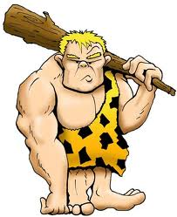
6 DEGREES OF SEPARATION
The Cave Man Approach
Lived in Clusters
The Modern World is connected because of Technology

Slide 10

6 DEGREES OF SEPARATION
Word 4 Word
I need your assistance. One of my top clients is looking to [expand its Sales Division by hiring an Account Executive Director to grow their relationships with systems integrators and other partners in the world of software development].
If you don’t know of someone you can refer me to, would you pass this on to a friend, colleague, or associate who you consider to be closer to this type of person?
I appreciate your consideration.

Slide 11
6 DEGREES OF SEPARATION
The Real Results
Sent out 300 Emails
84 Responses
15 passed it along
23 Names
12 Interested
4 Sendouts

Slide 12
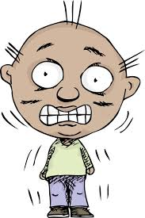
6 DEGREES OF SEPARATION
The Referral Call
People brought up in the Technology Age do not require emotional attention
I didn’t know if you might know someone…
Is there somebody who you know who might…
Tentative Passive Tone

Slide 13

6 DEGREES OF SEPARATION
The Referral Call
Is there somebody who you know who might be right for this?
Is there somebody who you know who might be looking?
Everyone you’ve ever met in your life!

Slide 14

6 DEGREES OF SEPARATION
The Referral Call
Confident, Assumptive Tone
Look, you’ve been doing this for 15 years. You’ve GOT to know people who can do this. Who do you know?

Slide 15


6 DEGREES OF SEPARATION
Qualifying the Referral
Ok, what do you know about her? Why did she come to mind? What do you think about her?
Is she active in the marketplace?

Slide 16

6 DEGREES OF SEPARATION
The Magic Phrase
I really appreciate your time. Who else comes to mind?
DEMsays GO TO Questions!
Who is the best [TITLE] you’ve ever worked with?
Who do you respect enough to want to help?

Slide 17

6 DEGREES OF SEPARATION
When the Candidate Asks…
Who do YOU think it is?
Who’s the company?
Other Sources of Referrals
Candidates that clients didn’t hire
Call ABOVE the level of the job
Companies that won’t pay your fee

Slide 18
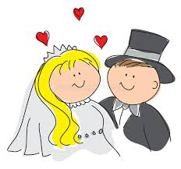

6 DEGREES OF SEPARATION
Other Sources of Referrals
When a candidate breaks your heart
Previous Placements you’ve made

Slide 19
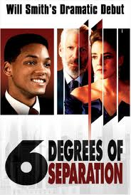
6 DEGREES OF SEPARATION
“Everybody on this planet is separated by 6 other people.
6 degrees of separation. Between us and everyone else on this planet. The President of the United States, a Gondolier in Venice, a native in a rain forest, an Eskimo. It’s a profound thought. Every new person is a new door opening up into other worlds”.

