Slide 1



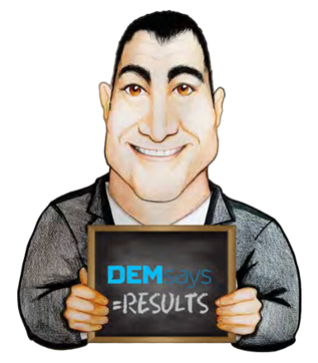
YOU’VE GOT MAIL

Slide 2


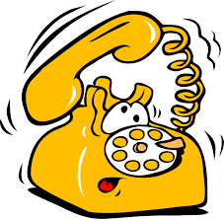
YOU’VE GOT MAIL
The Best Recruiters are not PACIFISTS
They LIKE…CONFLICT!
The more you
The less you’re

Slide 3
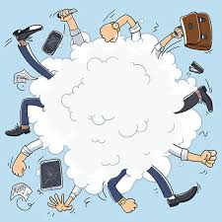

YOU’VE GOT MAIL
“Pick battles big enough to matter, small enough to win”
But which Battles?
Fee
Branding
Quality of Service

Slide 4


YOU’VE GOT MAIL
We fight to be the Agency of…
We MUST fight to be the Agency of…?

Slide 5

YOU’VE GOT MAIL
Average Recruiters talk to their clients, post Job Order…
Once a Week
JOBS!!
Great Recruiters talk to their clients post Job Order…
Every day at an appointed time

Slide 6

YOU’VE GOT MAIL
Talking Points…
I’m assuming you would be responsive to a recruited candidate who has another offer from your competitor, and I get them in the 11th hour. Is that right?
What is your preferred mode of communication?
When is your ‘quiet time’?
What is your preferred mode of communication?

Slide 7


YOU’VE GOT MAIL
1. When I first present a candidate
I’ll tell you right now, I’ll fight you on this. I HAVE to talk to you…
2. After the first interview
3. Offer Formulation
4. Counteroffer collaboration
5. Post Acceptance

Slide 8

YOU’VE GOT MAIL
But what if they say…
“I can’t work with someone who doesn’t value what I do”.
If you can’t differentiate yourself from other services, the customer defaults to the lowest? ________________

Slide 9
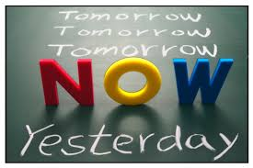
YOU’VE GOT MAIL
Presentation Calls
Present…
We have lost the PrEsent Part
…Now…
…Real Time
You say Email is FASTER?
Here is why it’s NOT…

Slide 10


YOU’VE GOT MAIL
In what mood?
1. You don’t know if they read it.
If they “got it”, got it.
16 Emails VS 3 phone calls
2. You can’t respond immediately. Interrupts…
3. Encourages unnecessary replies…Slows Closing

Slide 11

YOU’VE GOT MAIL
Other Email Problems…
1. You can’t take them back.
2. They can be forwarded.
3. We are meaner in Email.
TIP: REDUCE THE LENGTH OF YOUR EMAILS BY 50%
4. Take longer to write.

Slide 12
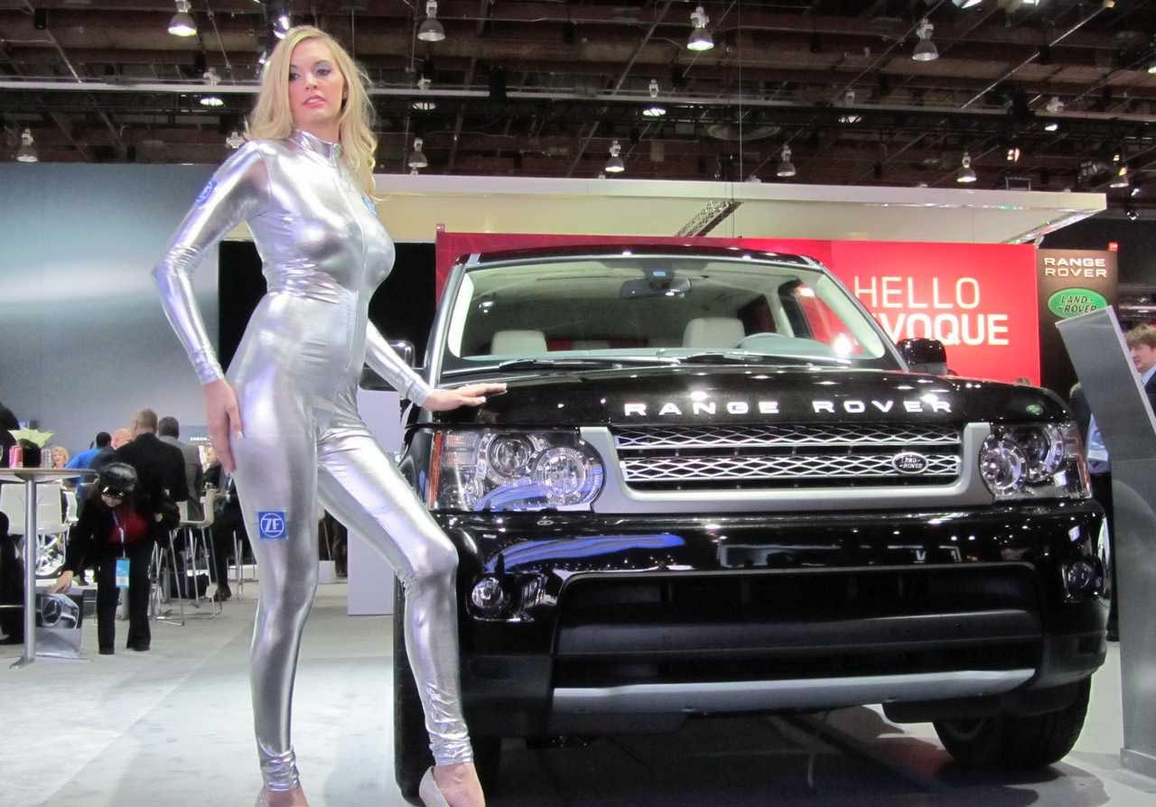
YOU’VE GOT MAIL
Presentation Calls
We have lost the PreSent Part
Auto Shows
Retainers
This Training

Slide 13
YOU’VE GOT MAIL
Dear Caroline, I’ve attached the CV for Susan K. I think you will be impressed with her ability to manage and develop new markets and accounts. She is a must see. With an intense drive to succeed and add to the growth of your organisation, Susan is a highly successful contributor to the achievement of results. Highly confident and competitive, she is always ready for new challenges and growth opportunities. Her keen ability to think strategically and see the big picture in addition to her strong FOCUS, and ability to prioritise necessary steps, makes her excellent at outlining plans of action to achieve overall goals. As a person who thinks more analytically, she effectively evaluates complex problems and responds well to negative situations utilizing an analytical approach to resolve situations. As a friendly person, she enjoys interacting with people and has a strong desire to develop employees and serve as a mentor for others. Her awareness of people’s individualized needs and her tendency to coach to maximize people’s natural talents help her contribute effectively to employees growth.
In summary, Susan is an excellent problem solver and is likely to be the ‘calm in the storm’ when conflicts and negative situations arise. Her calm and analytical approach to negativity assists her in successfully resolving these situations. An intuitive person, she also strives to help others understand different perspectives and the various sides of an issue. She is likely very good at sales as she is highly successful at achieving results and staying on track towards objectives, while also possessing a competitive drive that pushes her to continually improve.
Susan is a sales executive known for assembling high quality teams, developing effective growth strategies and exceeding company goals with strong leadership and talent management.
Caroline, let me know when you would like to see her! I look forward to your feedback.

Slide 14

YOU’VE GOT MAIL
If you MUST Email…
Back the Email up with a Voice Mail saying you’ve sent an Email.
Back the Voice Mail up with an Email saying that you’ve left a Voice Mail.
CUT, CUT, CUT….EDIT, EDIT, EDIT!

Slide 15
YOU’VE GOT MAIL
Attention
Interest
Desire
Action
Hi Mia,
Stop the search!
I have your next Visual Basic person for the Cape Town office.
Attached is the CV of Michelle H. Michelle HAS the Central Lab experience you need and has been selling Central Lab services in Cape Town for over 10 years.
As they say, read it and weep! She’s THAT good.
Call me to discuss in greater detail.
Senior Search Consultant

Slide 16

YOU’VE GOT MAIL
How to Make the Call
Pre-Close on a Time- Line
One last way out…
Give me alternative times when you can talk to candidates…
I’ve recruited, I have results…
Don’t rush. Call back if necessary.

Slide 17

YOU’VE GOT MAIL
How to Make the Call
1. Assumptive, confident tone.
2. Highlight/ Bullet Points.
3. Degree of Difficulty was high.
6. Link the candidates background to the search criteria.
4. Alternative Choice Close.
5. Offer an Account Summary.
7. The Catch! Chemistry Close

Slide 18

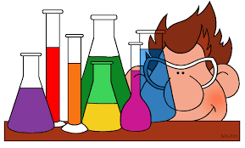
YOU’VE GOT MAIL
Alternative Methods…
1. The Chemistry Close
2. Reference Check Presentation
3. Collaboration Close

Slide 19

YOU’VE GOT MAIL
Alternative Methods…
TURN OFF EMAIL
SETTINGS/ LEAVE CELL IN CAR
CHECK EMAIL TWICE A DAY

Slide 20

YOU’VE GOT MAIL
Email Volume
Average person receives 50 – 200 Emails daily!
60% are work related
Humans are the same as computers
14%, 4 hours daily on emails
First, they slow down…
40% check emails constantly
Then they SHUT down!
From Microsoft: “Most abused form of communication”
25% who get interrupted by an Email don’t return to task for 2 hours!

