Slide 1



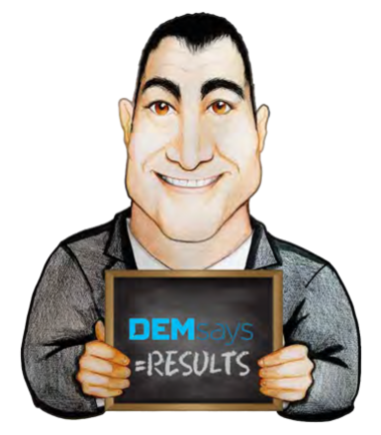
VALUE PROPOSITION 2.0!

Slide 2

VALUE PROPOSITION 2.0!
Envy as a Value Proposition
7 Deadly Sins
Gluttony
Greed
Wrath
Lust
Sloth
Pride
…and ENVY!

Slide 3


VALUE PROPOSITION 2.0!
Envy as a Value Proposition
Envy is not Jealousy
Jealousy: "I have something, and I want to keep it"
Envy: The response to another person's success, skills, or qualities that you desire or feel you lack

Slide 4


VALUE PROPOSITION 2.0!
Envy as a Value Proposition
Lazy Envy = “I wish I could…"
Actionable Envy = “How did she do it?”

Slide 5
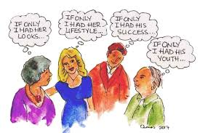
VALUE PROPOSITION 2.0!
Envy as a Value Proposition
People are most Envious of:
1. Money
2. Relationship Status
3. Fertility
4. Physical Traits
5. Social Media Status

Slide 6



VALUE PROPOSITION 2.0!
Envy as a Value Proposition
2 Types of Envy:
Malicious Envy
Benign Envy = The Essence of Fairness
Envy is Painful, literally!

Slide 7
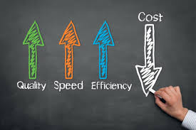


VALUE PROPOSITION 2.0!
Envy as a Value Proposition
Value Proposition History Lesson
Why do Clients use us?
Save time and money
We recruit candidates that you have no access to

Slide 8




VALUE PROPOSITION 2.0!
Envy as a Value Proposition
Managing the Process
Speed!
NEW! Competition and Competitive Intelligence

Slide 9

VALUE PROPOSITION 2.0!
Envy as a Value Proposition
To a Candidate:
“...No offence, but you don’t have any idea what you’re talking about…"
Voicemail or Email:
“…here is an inside look as to what’s going on in your niche…"

Slide 10

VALUE PROPOSITION 2.0!
Envy as a Value Proposition
With Presentations: “...you should talk to her because she’s worked for these companies…"
End of MPC Call:
“…I’ve got interest in her from ABC and DEF…”
At the time of an Offer: “…this is what your competitors are paying…"

Slide 11


VALUE PROPOSITION 2.0!
Alternative Value Proposition
Value Proposition of using a Recruiter: Verification!
Veronica
Kate Upton

Slide 12

VALUE PROPOSITION 2.0!
Alternative Value Proposition
False CV’s = 25%
False LinkedIn Profiles = 40%
“…the majority of my clients simultaneously try to fill the jobs on their own while they use me…”
LinkedIn is becoming a Sales Lead device
Always Update:
“WHY SHOULD WE WORK WITH YOU?"

Slide 13


CONTACT DEM
“…there is not much wrong in any of our lives that a placement doesn’t fix…”
082-929-5148
dem@demsays.co.za

