Slide 1



FOLLOW THE MONEY

Slide 2

Follow the Money!

Slide 3
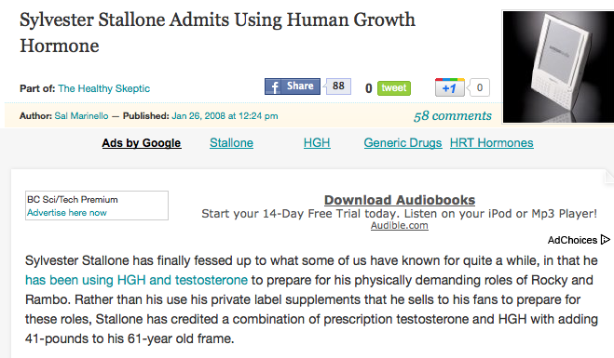
Follow the Money!

Slide 4
Follow the Money!
Top Billers Follow the Money!
NICHE

Slide 5
Follow the Money!
“I’ve got people for that”
Follow Ads
“The reason for my call is, I’m connected to your industry, and I’ve got several people in my network who tell me you’re looking for a [Title], and that is my specialty. I have no idea where you are in the search, or how many candidates you’ve already talked to, but I wanted to throw my hat in the ring and compete”.

Slide 6

Follow the Money!
Email Marketing
Want to know what the single fastest growing way to market is?
Here’s a clue…

Slide 7
Famous “FD” Call
Direct Recruiting Call: He said NO
Who do you know?
Got 2 CV’s!
Qualify the Referrals
How do you know these people?
Why are they sending CV’s?
Controller Job Lead
I just hired someone!
Where did he come from?
Who else did you Interview with?
Re-Recruit John
Where did John come from?
Where else did he Interview?

Slide 8
Working for Tips!
Getting Job Order Leads from Candidates
X
“I need you to compare this to the other things you are considering”
“What else have you got going?”

Slide 9
“I’m not taking your Job”
Follow the Money!
‘Now that it’s Over’ Close
“Now that it’s over…who can you recommend to me to help me save face with my client?”

Slide 10
“I’m taking a Counter Offer”
Follow the Money!
“…you’ve just taken a part time job! Who else do you know?”
Where else have you Interviewed?

Slide 11
“I AM taking your Job”
Follow the Money!
“…you are calling them and you are withdrawing, is that right?”
Make a Marketing Call!

Slide 12
A Tough Call!
Follow the Money!
Post- Resignation Call
“I understand you’re looking for a [TITLE]…it was just business.”
…You’ve got a lot of nerve!

Slide 13
Reference Check Marketing
Follow the Money!
…you can see that I care about the quality of the people that I represent, and if I were working with you, I would give you that same level of service. What type of openings do you have?

Slide 14
Debrief Marketing
Follow the Money!
…you recently interviewed one of my candidates and I wanted to get your feedback.
…What type of openings do you have?

Slide 15
The Last Question in the Placement Process
Follow the Money!
X
“Who do I send the Invoice to?”
“What’s the next search assignment?”

Slide 16
Answer to ‘No Vacancies’
Follow the Money!
“Where do YOU think I could send this candidate?”
“Do YOU know anybody who’s looking?”
“What would YOU do if you were me?”
“Who would YOU call?”

Slide 17
Some Final Tips…
Follow the Money!
1. Collaborative Planning
2. Trickle Down Marketing
3. Top Billers Avoid Big Business
4. Top Billers TRACK their Candidates
5. Top Billers DO make Marketing Calls!
6. Recommended Reading: Good to Great by Jim Collins

