Slide 1

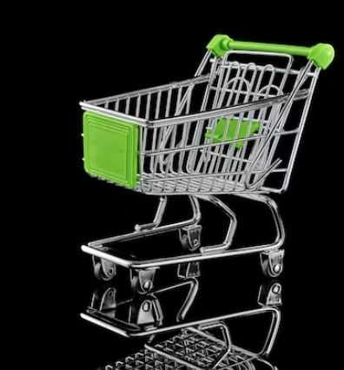


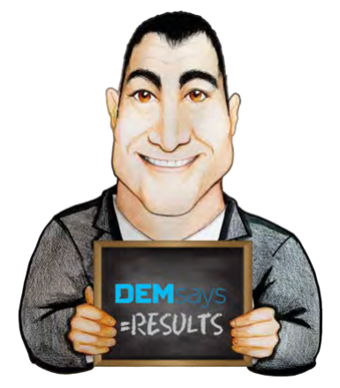
WINDOW SHOPPERS

Slide 2
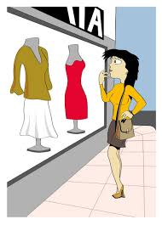
WINDOW SHOPPING CANDIDATES
Let’s go Shopping!
Window Shoppers are people who go to the mall and leave without buying anything.

Slide 3
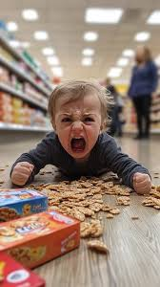
WINDOW SHOPPING CANDIDATES
Everything you need to know about Window Shopping Candidates…
They don’t want YOUR job…
…but they don’t want anyone else to have it!

Slide 4


WINDOW SHOPPING CANDIDATES
The 3 Types of Candidate Pain
VISUAL
I’m actively looking
ADMITTED
LATENT
There’s something missing
I’m in pain, but I didn’t know it

Slide 5


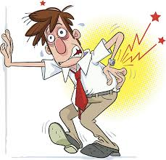
WINDOW SHOPPING CANDIDATES
What is pain’s function in your body?
To get you to stop doing something that is bad for your body.
Candidates who really have pain cannot ALLOW themselves to stay at their jobs.
Candidates who have an ACHE will stay at their jobs long after you send them out!

Slide 6


WINDOW SHOPPING CANDIDATES
Let’s go Shopping!
95 | Chips |  | T-Shirts | 19
45 | Juice |  | TV’s | 40
61 | Sun Block |  | Jeans | 8
160 | Shampoo |  | Phones | 19
75 | Cereal |  | Channels | 100

Slide 7
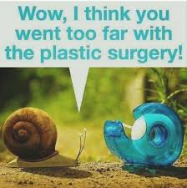
WINDOW SHOPPING CANDIDATES
Plastic Surgeons
23 000 | Liposuctions
165 000 | Breast Implants
73 000 | Face Lifts
55 000 | Tummy Tucks
140 000 | Eye Surgeries

Slide 8
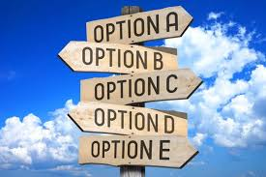
WINDOW SHOPPING CANDIDATES
When you have no choices, life is unbearable.
Beyond a certain level, choice no longer LIBERATES…
…It ____________!

Slide 9

WINDOW SHOPPING CANDIDATES
What do people consider when making buying decision?
The Sales Person
The Product
The Price
The Company
The Timing

Slide 10
WINDOW SHOPPING CANDIDATES
So, what does the Candidate do when they have so much choice?
You need to operate in such a way that you create TRUST with the Candidate, and YOU become the person they work with!
They look for ONE Recruiter that they can trust with their career.

Slide 11

WINDOW SHOPPING CANDIDATES
Remembering Maslow…
Self-Actualized
Tell me about yourself. What kind of position do YOU think is right for you?
Status
Sense of Community
Food, Shelter, Water

Slide 12

WINDOW SHOPPING CANDIDATES
Quick History Lesson
#1 Reason for Looking
#2 Reason for Looking
Advancement
#3 Reason for Looking

Slide 13
WINDOW SHOPPING CANDIDATES
The Job Presentation Call
What have you got?
Every single call you make, you should be asking yourself:
What am I trying to get accomplished on this call?
The Purpose of a Job Presentation Call is to SCHEDULE AN INTERVIEW!

Slide 14

WINDOW SHOPPING CANDIDATES
1. Big Picture: Define the Company
2. Snapshot
Now let me tell you how YOU fit into this.
You qualify candidates by having a job that is better than the one they have.

Slide 15
WINDOW SHOPPING CANDIDATES
3. Close: Your Solution
I thought this would be right for you because you said you were looking for XYZ and this is indeed that…
4. Scenario Selling Success Stories
5. Alternate Choice
Let me tell you what happened to the last 2 people who had this job…
I took the liberty of getting her schedule…

Slide 16
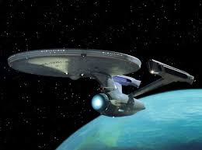
WINDOW SHOPPING CANDIDATES
In the world of the Pharmaceutical space…
…magic quadrant of level one sales professionals…
…infused with the highest level…braniacs
…secret sauce of clustering methodologies…

Slide 17
WINDOW SHOPPING CANDIDATES
Common Denominators
1. They use the term ‘we’ a lot: Here’s what WE need”
2. They always know:
a. The Clients Product
b. The Clients Turnover
c. The Value Proposition
3. They aren’t afraid to say “I don’t know”
4. They sell leadership

Slide 18

WINDOW SHOPPING CANDIDATES
“Serious” Candidates Questions
1.What’s the culture like?
2. Is it profitable?
4. Salary, Bonuses, Benefits?
3. Promotional prospects?
5. How many people have you placed there?

Slide 19

WINDOW SHOPPING CANDIDATES
“Shopping” Candidates Will Say…
“I’ll look at the website and get back to you”
It’s too early. We are not talking about you taking a job?
“I want to think about it”
Risk Vs Reward
“I want to talk to my spouse”

Slide 20

WINDOW SHOPPING CANDIDATES
Volvo Case Study
A HEURISTIC
CREDIBILITY
INFLUENCE

