Slide 1



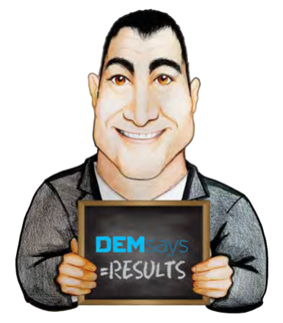
CLOSING FOR COWARDS

Slide 2

CLOSING FOR COWARDS
The Classic
We have a strong offer – Medium Sized Client
Candidate has an interview 5 days from now- a first interview at a Big Company
Company has a backup candidate [not ours]
It’s Friday. He’s Unemployed

Slide 3
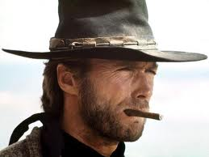
CLOSING FOR COWARDS
The Classic
THE TAKE IT AWAY CLOSE!
This calls for?

Slide 4
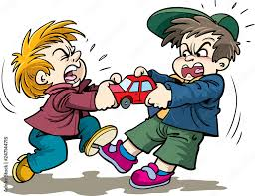
CLOSING FOR COWARDS
The “Take it Away” Close
You’ve had this offer for 4 days. That is not acceptable to me. I can tell this is not going to work. So, I’m going to call the company and tell them it’s over. [HANG UP!]

Slide 5

CLOSING FOR COWARDS
The “X” Factor
No Placements in 2 months
The company said to give it a week.
“He told me he was 99% sure he was taking it!”

Slide 6
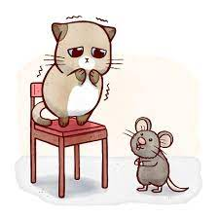
CLOSING FOR COWARDS
WHY?
”When I haven’t made a placement in a while, I don’t ask the tough questions”
“…but it’s not that I’m afraid…”

Slide 7

CLOSING FOR COWARDS
Let’s Ask the Big ???
Does being “______________” work?
Does trusting the “Company knows what they’re doing”, work?

Slide 8
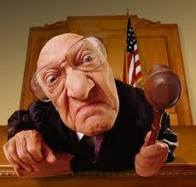
CLOSING FOR COWARDS
Let’s Ask the Big ???
If I push too hard, they will back out BECAUSE they are mad”.
“Who am I to judge”?

Slide 9

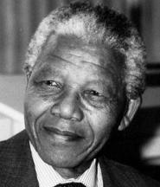

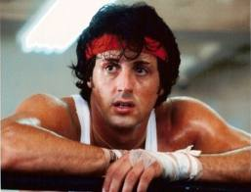
CLOSING FOR COWARDS
CLOSING FOR COURAGEOUS PEOPLE

Slide 10
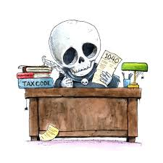
CLOSING FOR COWARDS
DEMsays 100% Rule
The death rate amongst human beings
%
=

Slide 11

CLOSING FOR COWARDS
You don’t need to go there!
BE a Coward
Cowards Close Deals
Being Afraid and Making Money
Cowards can’t close at offer time.
BUT…
They CAN close EARLY

Slide 12
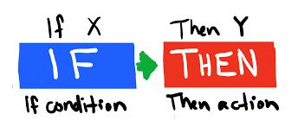
CLOSING FOR COWARDS
Quiet Closes
The “IF / THEN”
Close
So, what you’re saying is, IF……… THEN………, is that right?

Slide 13



CLOSING FOR COWARDS
Quiet Closes
Cowards should sms.
They should be wary of email.
There’s a problem.
We’re not going to get her. We need to speak.

Slide 14

CLOSING FOR COWARDS
Infrastructure: Cowards who Close…
Never send just ONE Candidate.
Never send a Candidate to ONE job.

Slide 15
CLOSING FOR COWARDS
What I CAN do for Candidates
I can evaluate your skills and cross-check them against my current clients needs. Depending on your requirements for salary, logistics, urgency, and let’s face it, how you interview versus the competition, I might be able to help you leverage your career into a better opportunity.

Slide 16

CLOSING FOR COWARDS
What I CAN do for Clients
I expose you to your competitors’ best people and give you an opportunity to compete for their talent.

Slide 17
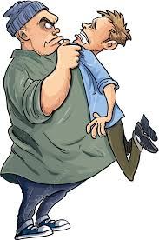
CLOSING FOR COWARDS
Cowards Collaborate
When the candidate has formed a deep bond.
When counteroffer needs revisiting.
When start date is in question.
Onboarding
When low salary needs justifying.
When the candidate intimidates you.

Slide 18
CLOSING FOR COWARDS
Cowards Also Collaborate with…
References
1. Do you think he should move?
Mentors
2. Have you told him?
Spouses
3. Don’t you think you should?

Slide 19

CLOSING FOR COWARDS
Cowards LOVE Voice Mail!
Cowards Calling Hours
5pm to 8pm
Track Call Backs!
6am to 8am

Slide 20

CLOSING FOR COWARDS
Fatigue makes Cowards of us all!
We learn:
Planning leads to Placements
Cowards know the fastest way to a Placement dictates the plan
Target
Call everyone [connections, NOT matches]
3 times a charm/ Referrals
Bleeders

Slide 21
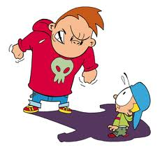
CLOSING FOR COWARDS
Cowards Know
The thing that scares them will scare candidates too.
Bully clients have the most openings and the hardest deals.

Slide 22

CLOSING FOR COWARDS
Cowards live in Fear!
But they are not anxious.
Anxiety is the anticipation of Danger
Fear is the Experience of Danger
Anxiety is followed by Anger
Fear is followed by ACTION!

