Slide 1

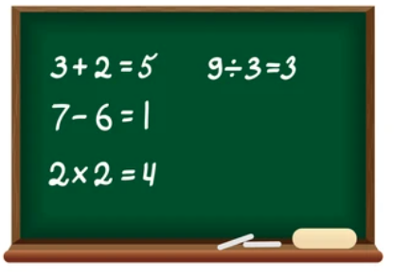


BIG BILLERS NUMBERS & RATIOS

Slide 2

NUMBERS AND RATIOS
Recruiter Training School
Planning!! It’s a Numbers business!
What’s the most important thing you do?
BUT, 80% of Recruiters DO NOT track their Numbers on a daily basis!

Slide 3


NUMBERS AND RATIOS
Why We Don’t Track Activity
1. We’re not sure which numbers are relevant
2. We’re not sure HOW to do it
3. We’re so disorganized personally, it seems hypocritical
4. It’s against our entrepreneurial natures
5. The companies that do well are the ones with the most structure!

Slide 4



NUMBERS AND RATIOS
Why We DO Track Activity
1. It is objective, clean, and impersonal
2. It allows you to predict trouble
3. High Performance Recruiters are extremely Numbers conscious

Slide 5

NUMBERS AND RATIOS
Ratios to LIVE by!
Sendout
TO
Placement
Ratio
How many people do you send out on interview before you make ONE Placement?

Slide 6

NUMBERS AND RATIOS
Acceptable Range?
Sendout
TO
Placement
Ratio
5-8 : 1

Slide 7

NUMBERS AND RATIOS
Ratios to LIVE by!
Call
TO
Job Order
Ratio
How many Marketing Calls does it take to secure a Job Order?

Slide 8

NUMBERS AND RATIOS
Acceptable Range?
Dials
TO
Call
TO
Job Order
56
TO
14
TO
1

Slide 9

NUMBERS AND RATIOS
Ratios to LIVE by!
2nd Sendout
TO
1st Sendout
How many times that I get a first interview, does the candidate get a second interview?

Slide 10


NUMBERS AND RATIOS
Acceptable Range?
Ideal
=
80%
The Client doesn’t want to see them again
The Candidate doesn’t want to go back
The Candidate took another Job

Slide 11

NUMBERS AND RATIOS
Ratios to LIVE by!
Presentation
TO
Sendout
How many times do I present a candidate or a CV and get a Send Out
I will send you a CV in support of an Interview

Slide 12


NUMBERS AND RATIOS
Acceptable Range?
Ideal
=
70% to 80%
One PURE Ratio
1
TO
1
Client Visit
TO
Job Order

Slide 13

NUMBERS AND RATIOS
Also Important to Track
% of Returned Voice Mail
Less than 30%
Change your Script!
=

Slide 14


NUMBERS AND RATIOS
Also Important to Track
Where the Candidates come from?
% from
Referrals
% from
Ads
% from
Internet
% from
Recruiting
% from
Database

Slide 15


NUMBERS AND RATIOS
Also Important to Track
The W’s of Fee Objections
Who is Objecting?
Where in the call?
What are we saying in reply?
Why won’t they agree?

Slide 16
NUMBERS AND RATIOS
DEMsays…
Do this is tough times and you will prosper. Do this ALL the time, and you’ll have less PAIN in tough times!

Slide 17
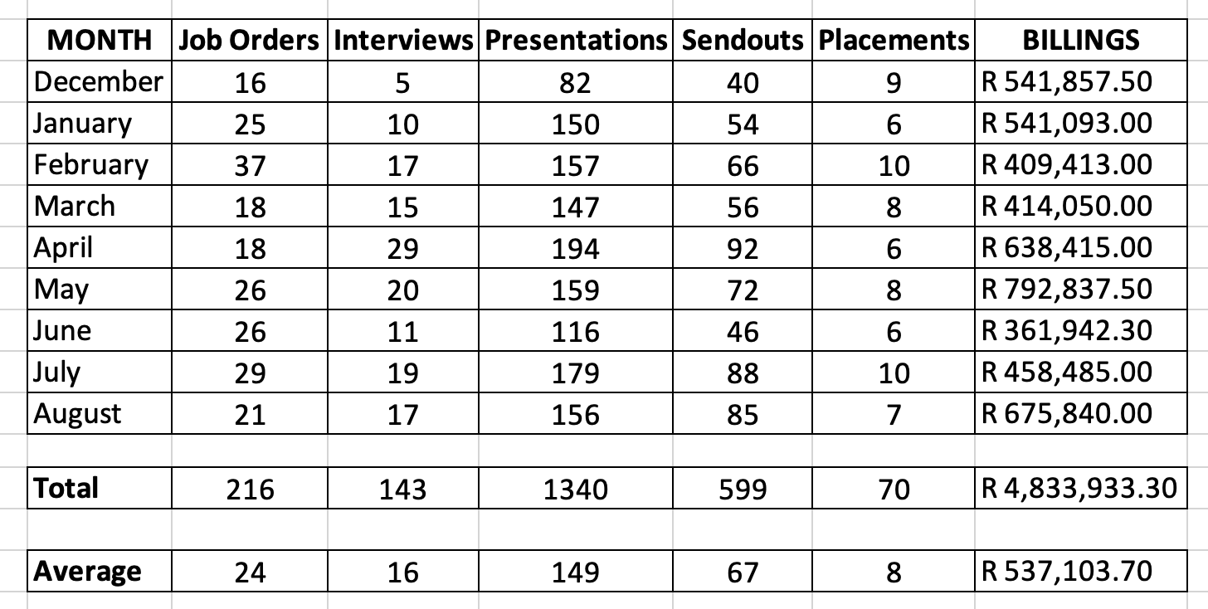
A Big Billers ACTUAL Numbers
Do this is tough times and you will prosper. Do this ALL the time, and you’ll have less PAIN in tough times!

