Slide 1



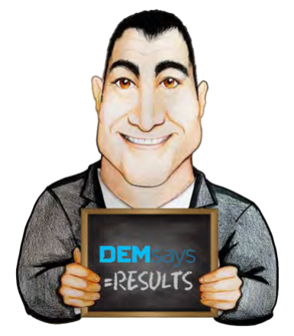
HURRY UP AND WAIT

Slide 2

HURRY UP AND WAIT
PSYCH 101: CLIENT BELIEFS
2. More choice is better than less
1. There are a lot of Candidates available in this market
3. Better to wait than hire the wrong person
4. Recruiters “exaggerate”

Slide 3
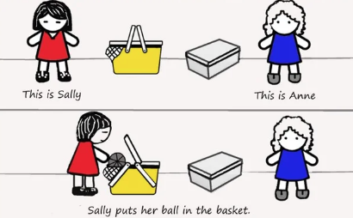
HURRY UP AND WAIT
SALLY – ANNE TEST
1. | Sally hides her marble in the box
2. | Sally leaves
3. | Anne moves Sally’s marble to the basket and then leaves
4. | When Sally returns, where does she look?
Their beliefs cannot deviate from the world as it really is

Slide 4


HURRY UP AND WAIT
The “Because it’s True” Constraint
Believe Green Tea is good
3 cups a day for 20 years
My mother did and her mother did too
I am CEO of Green Tea Inc.

Slide 5
HURRY UP AND WAIT
Bias and Beliefs
3 Assumptions
The greater the number of people who believe something, the more likely it is to be true
1. Ignorance Assumption
2. Idiot Assumption
3. Evil Assumption
This applies to our OWN beliefs, not to other people
Because I can!

Slide 6

HURRY UP AND WAIT
ZOMBIE!
EXP
Do you need someone right away?
+
When do you need somebody by?
SPECS
Do you have any real urgency?

Slide 7
HURRY UP AND WAIT
Case Study
HR and recruitment executives interviewed were unanimous in saying that time-to-fill is the number one metric that senior management cares about, more than cost-to-fill, and often far more. Most agreed that 90 days is the ‘gold standard’ of time-to-fill when averaging together all positions.

Slide 8

HURRY UP AND WAIT
Companies Don’t Need You…
…To Identify
… To Source
Companies Don’t Care About…
…Your Steps to the Placement Process

Slide 9
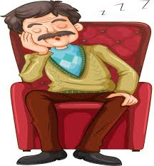

HURRY UP AND WAIT
They Mistakenly Believe
That social media gives them PASSIVE people
What They Need You For Is?

Slide 10

HURRY UP AND WAIT
Let’s Start by Showing Them We
…Get It
…Are Different

Slide 11
HURRY UP AND WAIT
1st Question on a Job Order
Have you ever felt the thrill of hiring after the first interview?
Here’s the perfect match…your competitors best person, and your lack of impulse control!
How fast can you hire?

Slide 12

HURRY UP AND WAIT
Sliding Scale
If I fill in 1 week | 20%
<21 Days | 17.5%
21 days – 30 days | 15%
Over 30 days | 12.5%
I’m taking a risk…

Slide 13

HURRY UP AND WAIT
1st Hour Versus 11th Hour
Great recruiters save the day, they don’t start the day!
Great recruiters sleep in!
Job definition will evolve
HR will assert itself
Internal candidates will surface
Budget/ Freeze/ Timing

Slide 14

HURRY UP AND WAIT
1st Hour Versus 11th Hour
But this we know…the job is still open
Some pipeline
Other agencies
HR has some input

Slide 15
HURRY UP AND WAIT
Client Types
What’s in this for you?
1. The “Not Fully Committed” Type
What happens if you don’t hire?
What has been your history at hiring the wrong people?
2. The “Fear of doing it Wrong” Type

Slide 16
HURRY UP AND WAIT
Client Types
BEWARE of the client who lets you over consult
3. The “You Tell Me” Type
They will be accessible for a few days, then they will disappear
4. The “Perfectionist” Type
What can we ‘give’ on for what you want? If I can’t find everything, would you still hire?

Slide 17
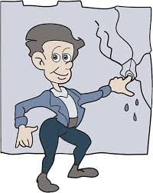
HURRY UP AND WAIT
Client Types
Can only fill holes
5. The “Don’t want to do the things they are supposed to do” Type
On a scale of 1 to 5, 1 being I hate to hire, 5 being I truly enjoy hiring, where are you?

Slide 18


HURRY UP AND WAIT
Test Urgency with a Retainer request
What direction is the Urgency coming from?
I know a person who fits…what is your schedule this week?
Give me your cell / FB invite

Slide 19

HURRY UP AND WAIT
DIVA
D ead on Fit
I nterested
V ery
A fraid

Slide 20

HURRY UP AND WAIT
The very best people are Diva's
They are high level performers
Have nothing to lose
Have options
A boss who will fight to keep them
A fear of change

Slide 21

HURRY UP AND WAIT
DIVA Demands
Immediate response
Flexibility with money / Internals
Bypass of process
A boss who will fight to keep them
YOU in sell mode
I have to coddle/ convince/ hand hold…and it’s worth it…but I need:

Slide 22


HURRY UP AND WAIT
Chronic Abusers
[NAME], once a quarter I sit down with my manager and reflect on the business I’ve done year to date.
We keep strict ratios here at [ABC Search], and through that exercise some things have become clear. I’m going to have to stop working with your company. This is purely a business decision as I have thoroughly enjoyed working with you.
My back is against the wall. There are some key obstacles keeping me from being successful with your company

