Slide 1



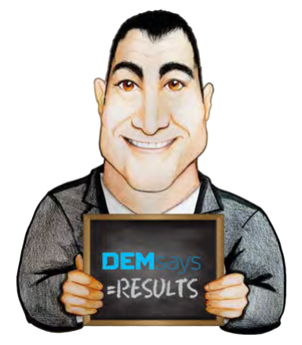
RETAINERS

Slide 2
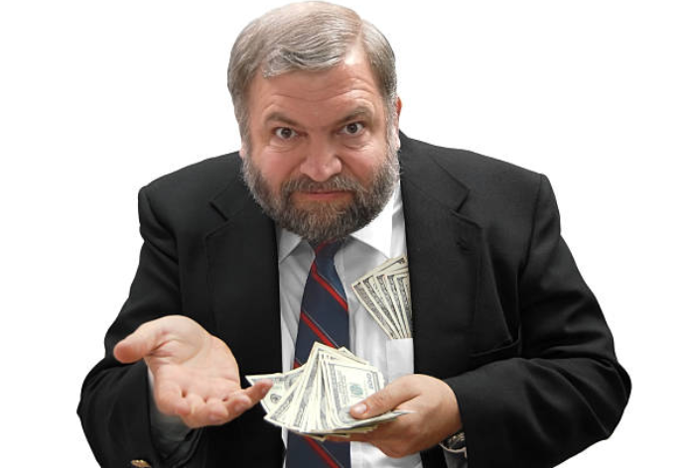
RETAINERS
Why work Retainers?
Fewer Collection Problems
Fewer Process Problems
Loyalty: Above 90%
Better Planning Skills
You end up being LED into a niche

Slide 3

RETAINERS
The Game Plan
Go to your existing clients
I want to talk to you about working in a different way.

Slide 4
RETAINERS
The Game Plan
Here are the points you’re going to make
You feel that they’re not getting enough service
You’re forcing me to get to you second.
I’m going to cut down on the number of clients I work with
I’m going to offer a HIGHER level of service to fewer clients.

Slide 5

RETAINERS
Selling the Process
1. We’re going to develop a job description TOGETHER, and then you’re going to APPROVE the job description and SIGN OFF on it.
2. My research team is going to meet.
We’re going to SHOW you what we do. Here’s what you get for your money.

Slide 6

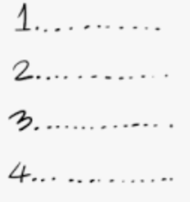
RETAINERS
Selling the Process
3. A Target List is formed
Who do you want us to call?
Who do you NOT want us to call?
I’m going to send you the Target List and you’re going to sign off on it.

Slide 7

RETAINERS
Add Ons
1. Account Summaries
Every week you get both a HARD SUMMARY of the actual phone calls, and a SOFT SUMMARY of some SUBJECTIVE FEEDBACK from the market.
2. Profile Portfolio
3 to 10 page document: This is why I think this is a MATCH.

Slide 8


RETAINERS
Add Ons
3. Quotes and Testimonials
4. Testing
5. Business Intelligence
6. Token Salary Surveys

Slide 9


RETAINERS
Qualifying Fees
The third up- front is NOT REFUNDABLE
Performance Based Retainer
ONE THIRD of the fee upfront shows me you’re committed.
No Guarantees!
The other 2 thirds I only need when I succeed.

Slide 10
RETAINERS
Qualifying Fees
Let me explain how we work. I work on a retained basis, but it’s a PERFORMANCE BASED Retainer. I charge one third upfront non- refundable and then I charge you the other two thirds when I succeed.
Close all new business on Retainer, but don’t volunteer your Guarantee!
From now on, qualify ALL your new jobs on a Retained basis

Slide 11
RETAINERS
Top Biller Techniques
Any candidate we recruit for your job we will not send to any other client until you pass on them.
First Right of Refusal
Guaranteeing a certain number of referrals by a certain time.
For this candidate I’ll charge you 20%. But if I’m going to work the job then you need to put me on a retained basis.
Converting candidate marketing calls into Retainers.

Slide 12


RETAINERS
Here’s what Companies Get
You will work it because you’ve been PAID to work it.
Commitment.
Our researchers work on retainers
and contingency jobs

Slide 13


RETAINERS
Here’s what Companies DON’T Get
You don’t get bombarded by other agencies.
You don’t get any rumours in the market based on the fact that you’ve given this job to so many contingency agencies.
You don’t get Shoppers.
You have ONE company that you can trust to have some CONFIDENTIALITY.

Slide 14

RETAINERS
What if you’ve never done one?
I have no HANDS- OFF restriction because I’ve never done this before.
Admit it.
You’ve got to make a passionate case for passion.

Slide 15

RETAINERS
Common Mistakes
Don’t give them an option!
Never send anybody in/ Working the Job before the Retainer comes in.
Reducing your fee on a retained basis because they’re taking away your risk, so you can justify it.
I can only start working it and making calls once the Retainer has been paid…
Taking a Contingency Hunger to a Retained Marketplace

Slide 16
RETAINERS
DEMsays…
“I’ve seen a lot of contingency recruiters who want to get into Retainer. I’ve never seen a Retained recruiter who wants to work contingency”.

