Slide 1


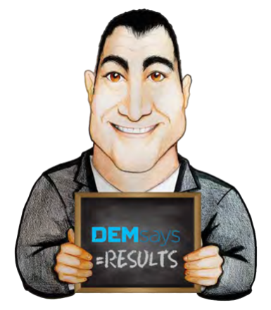

TELEPHONIC CANDIDATE SOURCING

Slide 2

TELEPHONIC CANDIDATE SOURCING
Name Gathering
Done at Reception level
No guilt or apology
Good understanding of the Org chart
Vocal Mirroring

Slide 3
TELEPHONIC CANDIDATE SOURCING
Name Gathering Script
And in NAME’S absence, who is second in charge?
Hi, who am I speaking to?
As I understand it, there are 2 or 3 people who actually report to NAME. Is that correct?
Hi NAME, this is YOUR NAME. How are you?
Tell me, who is the individual that heads the (IT, ACCOUNTING, ENGINEERING) side of the company?
Who are those people, because it’s at that level where my call needs to begin.

Slide 4

TELEPHONIC CANDIDATE SOURCING
BE HONEST WHEN QUESTIONED. YOU ARE NOT DOING ANYTHING ILLEGAL OR UNETHICAL. THIS IS RESEARCH.
Our company has an interest in doing business
with your company, and the knowledge of
your company’s breakdown will better prepare
us for our presentation to your company.
I’m just doing some DUE DILIGENCE on your company.
I’m just doing some RESEARCH on your company.

