Slide 1
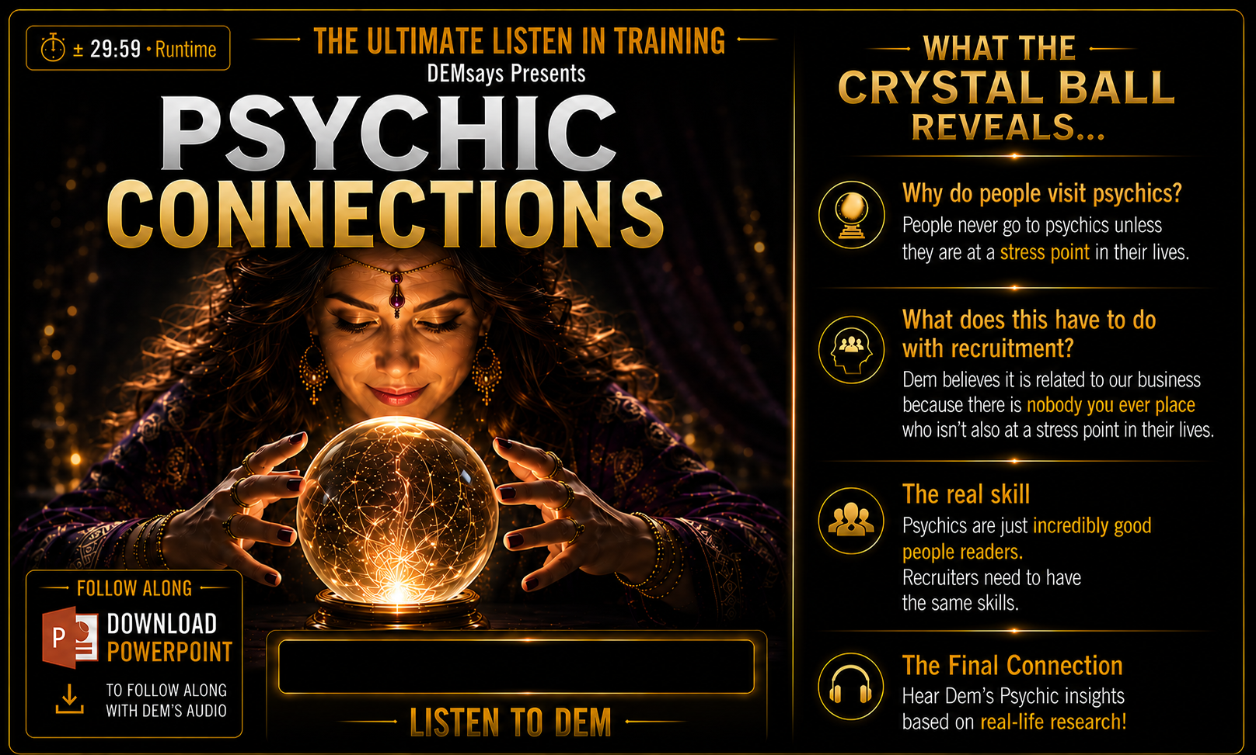


Slide 2
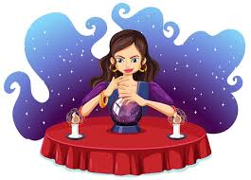
PSYCHIC CONNECTIONS
Definitions
The practice of conscious manipulation and autosuggestion
They will see into your...

Slide 3
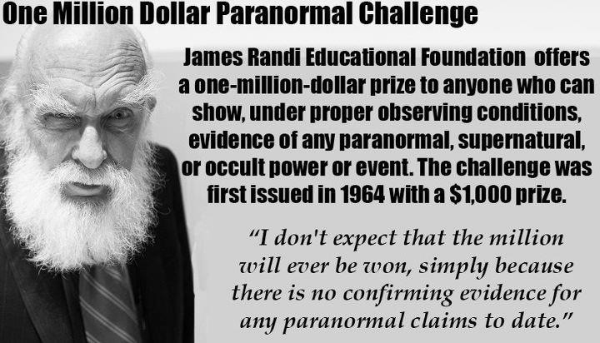
PSYCHIC CONNECTIONS

Slide 4

PSYCHIC CONNECTIONS
“They could not have known what they told me”!
Life Stress Points: Psychics AND Recruiters
People WANT Autosuggestion

Slide 5


PSYCHIC CONNECTIONS
Psychic School
Rule # 1: Make Money/ Intoxication!
“HOPE SELLS!”

Slide 6
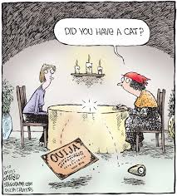
PSYCHIC CONNECTIONS
Psychic School
1. Cold Reading
Act with Confidence but be Humble!
Do your research
Manage Expectations:
“I’m often wrong”
Make Assumptions

Slide 7

PSYCHIC CONNECTIONS
Psychic School
2. “I’m seeing the Number 8…”
3. A “Tell”
Do you love me? Do I love you?
Contractions…I didn’t vs. I did NOT…
Adding unnecessary details

Slide 8
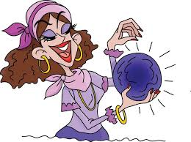
PSYCHIC CONNECTIONS
Psychic School
Distancing Language and Euphemisms
4. Getting you to take responsibility
5. HOT Reading
6. Confirmation Bias and Selective Thinking

Slide 9
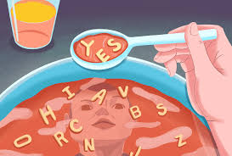
PSYCHIC CONNECTIONS
Psychic School
7. Self Deception
“People make new decisions based on new information…” – Zig Ziglar
8. Apophenia – connecting seemingly unrelated things

