Slide 1



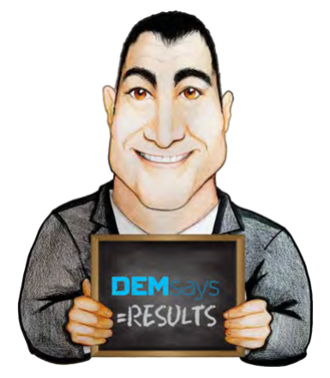
RECRUITER ETHICS

Slide 2


RECRUITER ETHICS
Values, Morals, Ethics?
INTERNALLY defined and adopted.
Ethics
EXTERNALLY imposed on other people.
Morals

Slide 3

RECRUITER ETHICS
Standards and Ethical Practices
Members shall treat all information relating to the business of Clients with confidentiality.

Slide 4
RECRUITER ETHICS
Standards and Ethical Practices
Members shall respect the rights of competitors and refrain from defamatory statements or acts of unfair competition.

Slide 5
RECRUITER ETHICS
Standards and Ethical Practices
Members shall not discriminate unfairly against any Candidate at any time in the recruitment process, except when obliged to do so in terms of prevailing legal requirements, regardless of ethnic origin, colour, gender, age, religion, political opinion, nationality, social origin, sexual orientation, or any other distinguishing characteristics

Slide 6
RECRUITER ETHICS
Standards and Ethical Practices
Members shall not, directly or indirectly, approach a Candidate currently in a position placed by them with an offer of alternate employment, unless the Candidate initiates
re-activation of their application.

Slide 7



RECRUITER ETHICS
Values, Morals, Ethics?
Legal but not Ethical or Moral
Moral and Legal, but not Ethical
Moral and Ethical, but not Legal

Slide 8

RECRUITER ETHICS
The Trolley Hypothetical
Most people say:
TURN!!!!

Slide 9
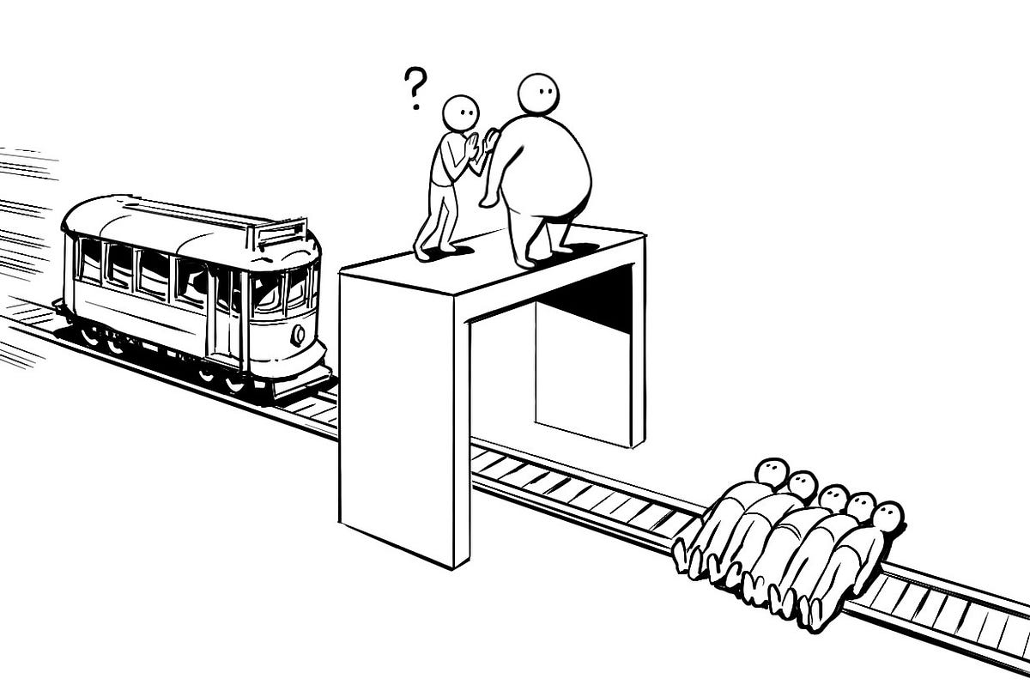
RECRUITER ETHICS
The Trolley Hypothetical
Most people say:
No! It would be terribly wrong.

Slide 10


RECRUITER ETHICS
The Moral Difference
The Moral Difference lies not in the EFFECT, but in our INTENTION

Slide 11

RECRUITER ETHICS
Ethics Evolve
It was once considered “unethical” to recruit a candidate during the day!

Slide 12

RECRUITER ETHICS
DEMsays: What is a Client?
They are in your area of specialization. Not a one time hit and run.
You do repeat business.
Regardless of current vacancies, the relationship is inherently ‘ongoing’
The relationship is one of mutual respect.
You have several contacts within the client, not just a friendly voice.
At least one of those contacts is a decision maker at the senior level.

Slide 13
RECRUITER ETHICS
Recruiting from Client
Ok, “if they called you”
REALLY?!
Need someone JUST like you.
Update Candidate: Tone?
How are things? Working out the way you wanted them to?

Slide 14

RECRUITER ETHICS
Recruiting from Client
If you opt for this Slippery Slope…
Demand an email stating you did not solicit them.
Policy
Most recruiters have one- year hands off policy.
“The Moral Mind” in the heat of the battle.
BEST Policy?
NEVER!

Slide 15

RECRUITER ETHICS
How do I fill an opening I created?
Hi Dem,
What’s the best way to approach a company to fill a vacancy that I created by Headhunting their Sales Director? Someone is going to get paid to
fill that position, why not me?

Slide 16

RECRUITER ETHICS
Where are you interviewing?
How long do I wait?
Did you tell the truth?
I don’t want to double up on your efforts.

Slide 17
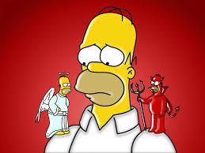
RECRUITER ETHICS
Immoral and Unethical
Suggest what you fear most
We’re down to 2 candidates, yours and one for a lower fee. We prefer yours, and would probably hire him, if the fees were the same. I just wanted to talk this through with you.

Slide 18

RECRUITER ETHICS
Immoral and Unethical
They hired behind our back.
1. Don’t invoice and hope.
2. Make a call – Chill!
3. Just need to confirm and invoice ASAP.
4. Forget the threat of no future business.
5. Don’t rebut their version.
6. Offer documentation. Present legal option.
7. Settle for no less than half.

Slide 19

RECRUITER ETHICS
Candidate is a Liar
Hi Dem,
As I worked this job, I called up one of the candidates I know in our database. Because I know him, I told him all about the job and the name of the client.
Once I was finished, he had the nerve to tell me he had heard about it from another agency yesterday, and he was already presented this morning. Now, I have known this candidate for a while, and I happen to know he is a liar. He lies about his numbers and his achievements. Isn’t it my job to inform my client, who is the party who actually pays my fee, that this candidate is misrepresenting himself and shouldn’t be considered? What do I do?

Slide 20
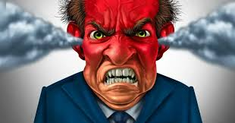
RECRUITER ETHICS
Ethical, Moral, Legal
Keep your people happy and we’ll have no problems…
It’s come to my attention you are recruiting my people when they are trying to work. Cease and desist!

Slide 21

RECRUITER ETHICS
Delicate Dilemma
My client wants out and I’m sending him/ her candidates at the same time.
Confidentiality Trumps Truth

Slide 22

RECRUITER ETHICS
Delicate Dilemma
If it feels wrong, it’s wrong.
They went with another candidate. Let’s move on.
Kindness Trumps Truth

Slide 23

RECRUITER ETHICS
DEMsays…
“It takes years to build a reputation. Minutes to bring it crashing down”
BAD REPUTATION!

